Slide 1

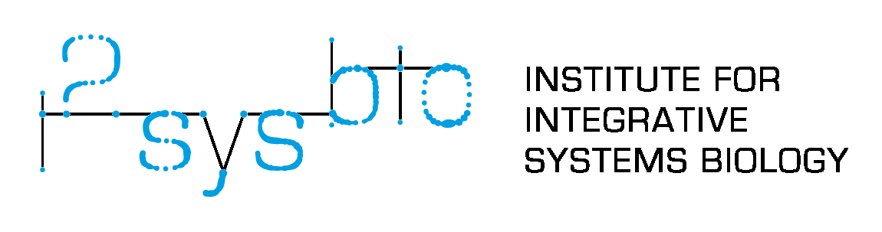



Stochastic dynamic modeling of evolving gene expression programs
Lucas Goiriz
Doctoral Thesis Defense
Thesis Advisors
Guillermo Rodrigo Tárrega (CSIC – UV)
J. Alberto Conejero Casares (IUMPA – UPV)
GVA ACIF 2021/083
Stoch. Dyn. Mod. of evolving gene expression programs
Valencia, July 25th, 2025
Lucas Goiriz, (CSIC – UV; UPV)
Notes:
Formal introduction
- Mention investmat and why Mathematics
\definecolor{netgreen}{RGB}{47,228,200}
\definecolor{darkergreen}{RGB}{47,202,163}
\definecolor{darkestgreen}{RGB}{47,175,145}
\definecolor{lightgreen}{RGB}{91,247,212}

Slide 2
Index
Introduction (Chapter 1)
Objectives (Chapter 2)
Chapter 3: A variant-dependent molecular clock with anomalous diffusion models SARS-CoV-2 evolution in humans
Chapter 4: PyEvoMotion: a software to perform the temporal statistical analysis of genome evolution
Chapter 5: Deciphering microscopic drivers of viral genome-scale molecular clock dynamics
General Discussion
Conclusions
Stoch. Dyn. Mod. of evolving gene expression programs
Valencia, July 25th, 2025
Lucas Goiriz, (CSIC – UV; UPV)
Notes:
This session's structure is the following:
We're going to start with a brief introduction, followed by the main objectives of the thesis.
Chapter 2 explores the variant-dependent molecular clock in SARS-CoV-2, providing a detailed analysis of how mutation rates and diffusion patterns vary between viral variants.
Chapter 3 introduces PyEvoMotion, a software tool developed for high-throughput evolutionary analysis, and demonstrates its application to large genomic datasets.
Chapter 4 delves into gene-level evolutionary dynamics, revealing the mosaic nature of viral genome evolution and the importance of local selection pressures.
Finally, we will close up with a discussion of the main results and the main conclusions of this thesis.
Without further ado, let's begin.

Slide 3



Introduction: Genotype-to-Phenotype - The Program Behind Life
Transcription
& Translation
Genes are not passive, they “execute code in response to biological inputs”
Stoch. Dyn. Mod. of evolving gene expression programs
Valencia, July 25th, 2025
Lucas Goiriz, (CSIC – UV; UPV)
Notes:
One of the fundamental paradigms in biology is the genotype-to-phenotype map. What’s powerful here is the idea that genes don’t simply “exist” — they act. DNA contains code, and this code is interpreted, transformed, and executed within the cellular context. One can think of cells as biological computers. The genome is the source code, transcription and translation are the compiler steps, and the resulting behavior — protein expression and phenotypic traits — is the output. This analogy underpins much of modern systems biology, synthetic biology, and gene circuit modeling. Genes are conditional: they respond to internal and external cues, and it is through models that we can infer how those inputs affect downstream behavior.

Slide 4


Introduction: Genotype-to-Phenotype - The Program Behind Life
Transcription
& Translation
Compilation
Genes are not passive, they “execute code in response to biological inputs”
Cells interpret DNA much like compilers transform source code into functional programs
Stoch. Dyn. Mod. of evolving gene expression programs
Valencia, July 25th, 2025
Lucas Goiriz, (CSIC – UV; UPV)

Slide 5
Introduction: Genotype-to-Phenotype - The Program Behind Life
Transcription
& Translation
Compilation
Genes are not passive, they “execute code in response to biological inputs”
Cells interpret DNA much like compilers transform source code into functional programs
Phenotypes arise from this dynamic gene expression process
Stoch. Dyn. Mod. of evolving gene expression programs
Valencia, July 25th, 2025
Lucas Goiriz, (CSIC – UV; UPV)

Slide 6
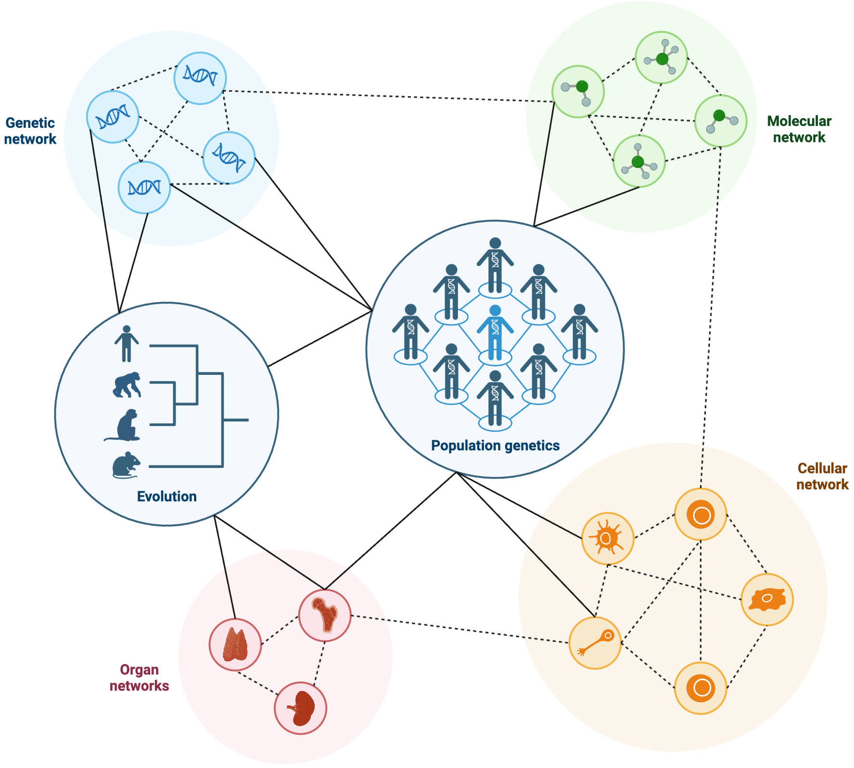
Introduction: Gene Expression as a Dynamic, Modelable System
Gene expression is dynamic: it involves RNA synthesis, translation, and molecular interactions
(Adapted from Villa & Sonis (2020))
Stoch. Dyn. Mod. of evolving gene expression programs
Valencia, July 25th, 2025
Lucas Goiriz, (CSIC – UV; UPV)
Notes:
Furthermore systems are characterized by multi-scale complexity, with interactions spanning from molecules to entire ecosystems. Traditional experimental approaches, while powerful, often cannot fully capture this complexity, especially when it comes to emergent properties that arise from the interplay of numerous components, and thanks to the advent of next generation sequencing technologies, massive amounts of data. Mathematical modeling has thus become an indispensable tool to capture these interaction and provide a structured framework for analyzing biological processes, generating hypotheses, and integrating experimental data into a coherent representation of larger systems. They allow us to make quantitative predictions, test hypotheses (like behaviors in case of perturbations or passing of time) under controlled in silico conditions, and uncover insights that might be challenging or impossible to observe directly.

Slide 7
Introduction: Gene Expression as a Dynamic, Modelable System
Gene expression is dynamic: it involves RNA synthesis, translation, and molecular interactions
Regulatory networks process signals and produce outputs
(Adapted from Villa & Sonis (2020))
Stoch. Dyn. Mod. of evolving gene expression programs
Valencia, July 25th, 2025
Lucas Goiriz, (CSIC – UV; UPV)

Slide 8

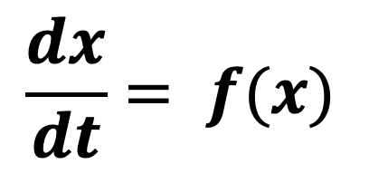
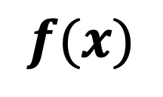
Introduction: Gene Expression as a Dynamic, Modelable System
Gene expression is dynamic: it involves RNA synthesis, translation, and molecular interactions
Regulatory networks process signals and produce outputs
Mathematical models clarify how genes behave, and misbehave
$$f(x)$$
$$\frac{dx}{dt}= f(x)$$
(Adapted from Villa & Sonis (2020))
Stoch. Dyn. Mod. of evolving gene expression programs
Valencia, July 25th, 2025
Lucas Goiriz, (CSIC – UV; UPV)

Slide 9
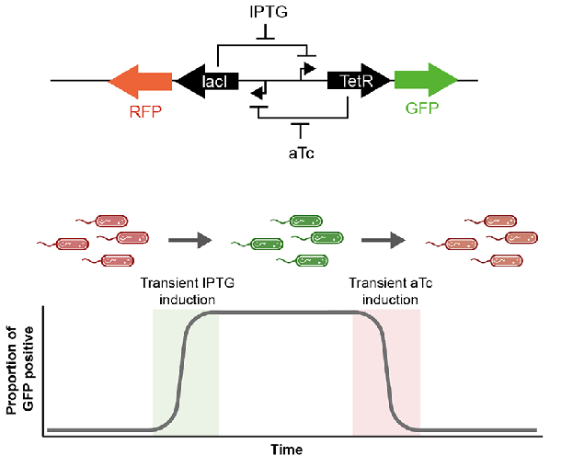
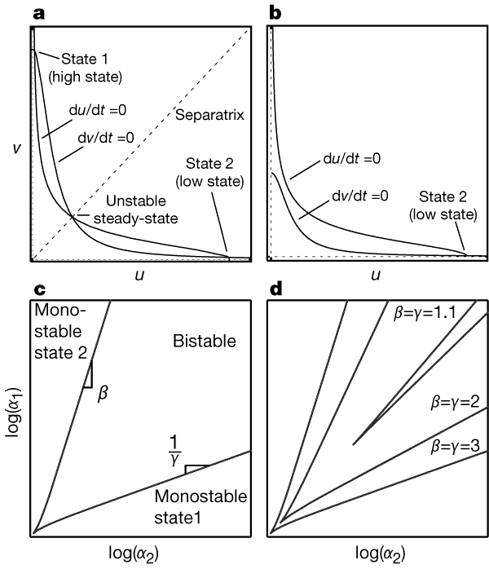
Introduction: Gene Expression as a Dynamic, Modelable System
Parameterization 1 (bistability)
Parameterization 2 (monostability)
(Adapted from Aggarwal et al. (2022))
(Adapted from Gardner et al. (2000))
Stoch. Dyn. Mod. of evolving gene expression programs
Valencia, July 25th, 2025
Lucas Goiriz, (CSIC – UV; UPV)

Slide 10




Introduction: Gene Expression as a Dynamic, Modelable System
Reaction
Regulation
RNA
DNA
Protein
Gene expression programs are not static: they evolve
Stoch. Dyn. Mod. of evolving gene expression programs
Valencia, July 25th, 2025
Lucas Goiriz, (CSIC – UV; UPV)
Notes:
Additionally, one can take the time dimension into account, which results in the observation that these gene programs evolve. Unlike software, biology is never version-locked, it's constantly being rewritten. Mutations randomly edit the "code", and whether those edits persist depends on selection and drift. Over generations, these random edits shape entirely new regulatory architectures. This is why understanding gene expression and evolution together is crucial. Genes aren’t just functional units — they’re historical objects shaped by randomness, constraints, and adaptation.
In other words, even beneficial mutations can be lost by chance. Drift can fix alleles regardless of their fitness. Recombination can unlink advantageous traits. This inherent stochasticity means that deterministic models alone, traditionally used in gene expression programs, won’t suffice. Instead, we model evolution with probabilistic tools — we simulate, we infer, and we use randomness not as an error, but as an essential mechanism. This is the bridge from biological insight to formal modeling.
Markov model, Wright-Fisher models, and their diffusion or coalescent extensions, capture the randomness of how alleles fix or disappear in populations.
These aren’t isolated methods, they’re part of a toolkit we use to simulate and infer evolution, by setting the focus more on the evolutionary dynamics rather than in the logic of the gene expression program
RNA viruses are exemplary systems for studying evolutionary dynamics. Due to their short generation times and large population sizes, allow us to observe evolutionary processes in real time, enabling us to rigorously test evolutionary theories and refining our understanding of how genetic variation arises and spreads. The insights gained from studying RNA viruses propagate beyond virology, informing broader questions in evolutionary biology, epidemiology, and systems biology.
However, given the evolutionary timescales of complex organisms, observing evolutionary trajectories to refine these models is an imposible task. Luckily, fast evolving agents with rapid evolution and high mutation rates
exist: RNA viruses. In the present thesis, we will make use of them to gain insights over biological evolutionary dynamics.

Slide 11

Introduction: Gene Expression as a Dynamic, Modelable System
Reaction
Regulation
Random Changes
Input
RNA
Output
DNA
Protein
Program
Gene expression programs are not static: they evolve
Over generations, random edits shape entirely new regulatory architectures
Stoch. Dyn. Mod. of evolving gene expression programs
Valencia, July 25th, 2025
Lucas Goiriz, (CSIC – UV; UPV)

Slide 12
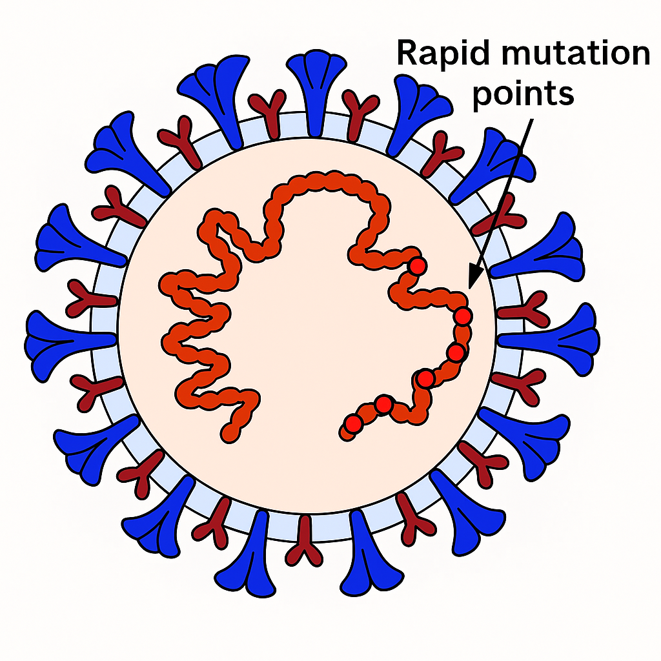
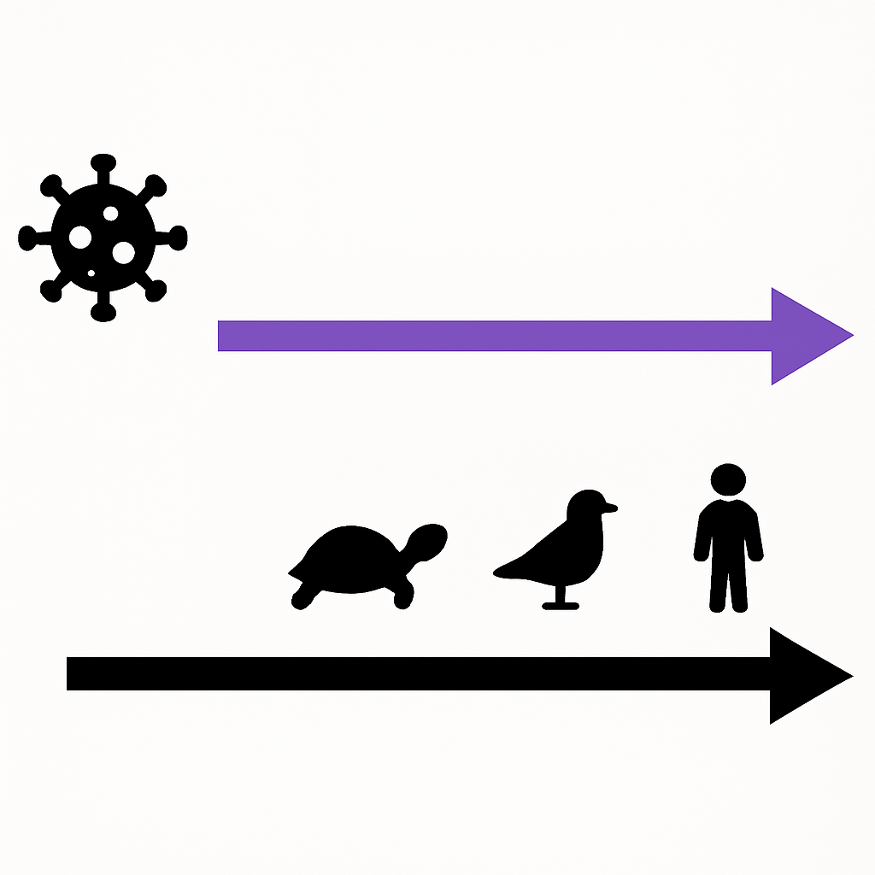
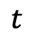
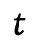
Introduction: Viruses as Models for Studying Evolution
Compressed Timescales in Viruses
Days/weeks
$$t$$
Virus as a molecular program
Centuries/millenia
RNA
$$t$$
Short generation times
Large population sizes
High evolution rates
DNA
Protein
(Adapted from Zhang et al. (2021))
Stoch. Dyn. Mod. of evolving gene expression programs
Valencia, July 25th, 2025
Lucas Goiriz, (CSIC – UV; UPV)

Slide 13
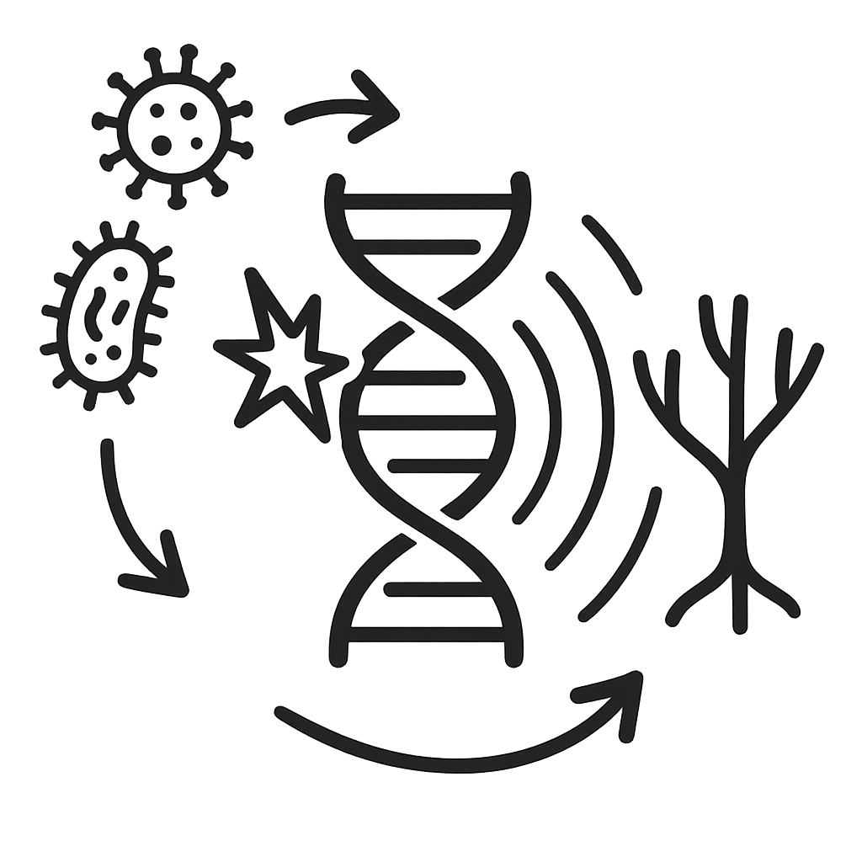
Objectives
Investigate the underlying stochastic processes and localized mutation dynamics in rapidly mutating biological systems, assessing how these micro-level events collectively influence macroscale evolutionary outcomes.
Stoch. Dyn. Mod. of evolving gene expression programs
Valencia, July 25th, 2025
Lucas Goiriz, (CSIC – UV; UPV)
Notes:
In particular, the objectives of this thesis are 4:
<Lee los objetivos uno a uno>

Slide 14
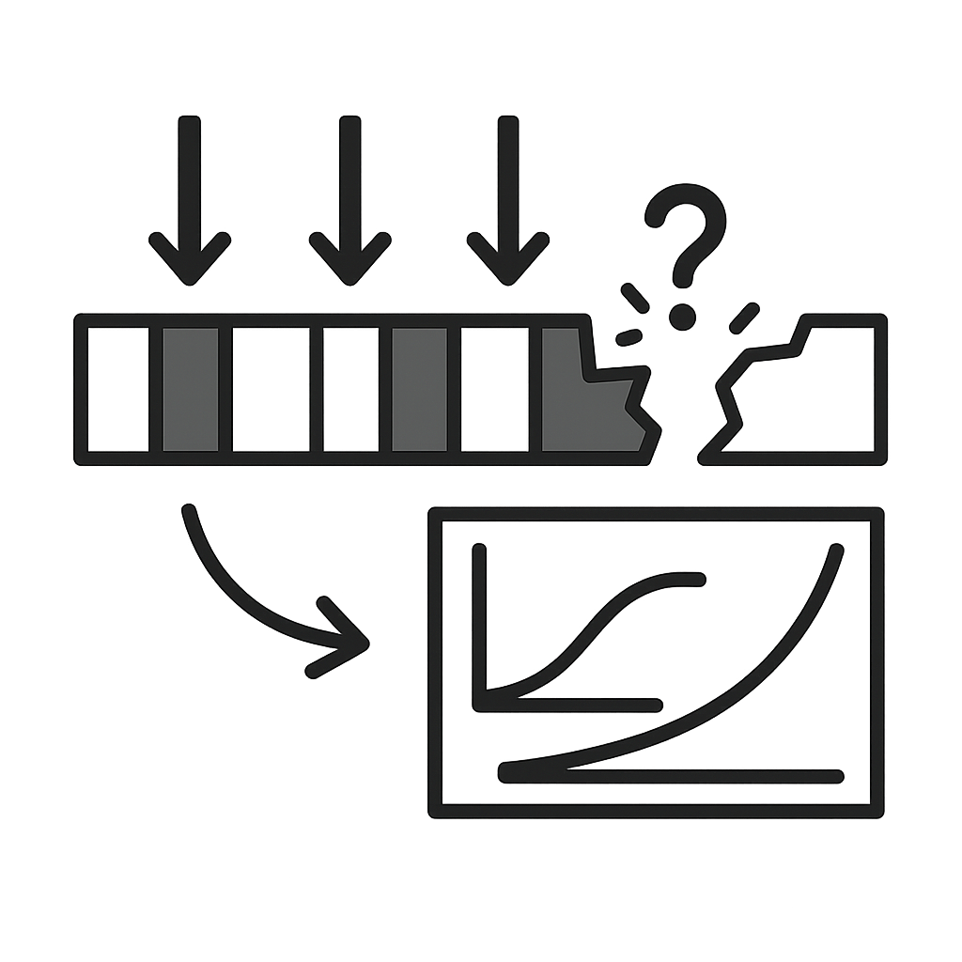
Objectives
Investigate the underlying stochastic processes and localized mutation dynamics in rapidly mutating biological systems, assessing how these micro-level events collectively influence macroscale evolutionary outcomes.
Evaluate selective pressures across diverse genomic segments and identify deviations from classical evolutionary models by employing alternative quantitative frameworks to elucidate patterns of adaptation and constraint.
Stoch. Dyn. Mod. of evolving gene expression programs
Valencia, July 25th, 2025
Lucas Goiriz, (CSIC – UV; UPV)
Notes:
<Lee los objetivos uno a uno>

Slide 15

Objectives
Investigate the underlying stochastic processes and localized mutation dynamics in rapidly mutating biological systems, assessing how these micro-level events collectively influence macroscale evolutionary outcomes.
Evaluate selective pressures across diverse genomic segments and identify deviations from classical evolutionary models by employing alternative quantitative frameworks to elucidate patterns of adaptation and constraint.
Verify whether the molecular clock hypothesis holds in rapidly mutating biological systems or if significant deviations arise due to localized genetic variability.
Stoch. Dyn. Mod. of evolving gene expression programs
Valencia, July 25th, 2025
Lucas Goiriz, (CSIC – UV; UPV)
Notes:
<Lee los objetivos uno a uno>

Slide 16

Objectives
Investigate the underlying stochastic processes and localized mutation dynamics in rapidly mutating biological systems, assessing how these micro-level events collectively influence macroscale evolutionary outcomes.
Evaluate selective pressures across diverse genomic segments and identify deviations from classical evolutionary models by employing alternative quantitative frameworks to elucidate patterns of adaptation and constraint.
Verify whether the molecular clock hypothesis holds in rapidly mutating biological systems or if significant deviations arise due to localized genetic variability.
Develop and implement integrated computational and statistical methodologies, coupled with novel large-scale open-source data treatment approaches, to bridge localized evolutionary events with comprehensive genomic-scale dynamics while ensuring reproducibility and scalability.
Stoch. Dyn. Mod. of evolving gene expression programs
Valencia, July 25th, 2025
Lucas Goiriz, (CSIC – UV; UPV)
Notes:
<Lee los objetivos uno a uno>

Slide 17
Chapter 3: A variant-dependent molecular clock with anomalous diffusion models SARS-CoV-2 evolution in humans
Goiriz L, Ruiz R, Garibo-i-Orts O, Conejero J.A, Rodrigo G. (2023)
A variant-dependent molecular clock with anomalous diffusion models
SARS-CoV-2 evolution in humans. Proc. Natl. Acad. Sci. U.S.A., 120(30): e2303578120
Stoch. Dyn. Mod. of evolving gene expression programs
Valencia, July 25th, 2025
Lucas Goiriz, (CSIC – UV; UPV)
Notes:
With the objectives in place, I’ll now guide you through how they materialize across the chapters of this thesis.
Let’s begin with Chapter 3, where we examine the evolutionary patterns over SARS-CoV-2 during the first 120 weeks of the 2019’s COVID pandemic

Slide 18
The Molecular Clock Hypothesis
Definition: Molecular Clock (Zuckerkandl & Pauling, 1965)
The rate of evolution of a gene is constant over time
Stoch. Dyn. Mod. of evolving gene expression programs
Valencia, July 25th, 2025
Lucas Goiriz, (CSIC – UV; UPV)
Notes:
To ground our understanding of the evolutionary analysis in this chapter, we begin with the molecular clock hypothesis. Defined formally as shown in the slide it states that gene evolution occurs at a constant rate over time, providing a quantitative method for measuring evolutionary divergence. This foundational idea, proposed by Zuckerkandl and Pauling, forms the basis for many evolutionary and phylogenetic models.
It is only with Motoo Kimura’s Neutral Theory of Molecular Evolution, formalized in Definition 3.1.2. This theory posits that most molecular changes are selectively neutral and accumulate via genetic drift rather than adaptive evolution. It provides a theoretical justification for the molecular clock. The number of substitutions N(t) over time follows a Poisson process with constant rate μ, such that the probability of observing k mutations in time t is given by:
P(N(t)=k)=(μt)ke−μtk!P(N(t) = k) = \frac{(\mu t)^k e^{-\mu t}}{k!}P(N(t)=k)=k!(μt)ke−μt​
Here, both the mean and variance of the process equal μt, encapsulating the idea of linearity in time, statistically equivalent to Brownian motion. However, despite early studies supporting this framework, real-world data — particularly from rapidly evolving organisms like RNA viruses — reveals substantial deviations. The mutation patterns often show that variance exceeds the mean — a phenomenon known as overdispersion, contradicting the predictions of a pure Poisson process. These discrepancies suggest additional factors like episodic selection, bottlenecks, or variant replacement dynamics may be at play. SARS-CoV-2, with its massive sequencing effort and rapid evolutionary shifts, serves as an unparalleled natural experiment to probe these assumptions.

Slide 19
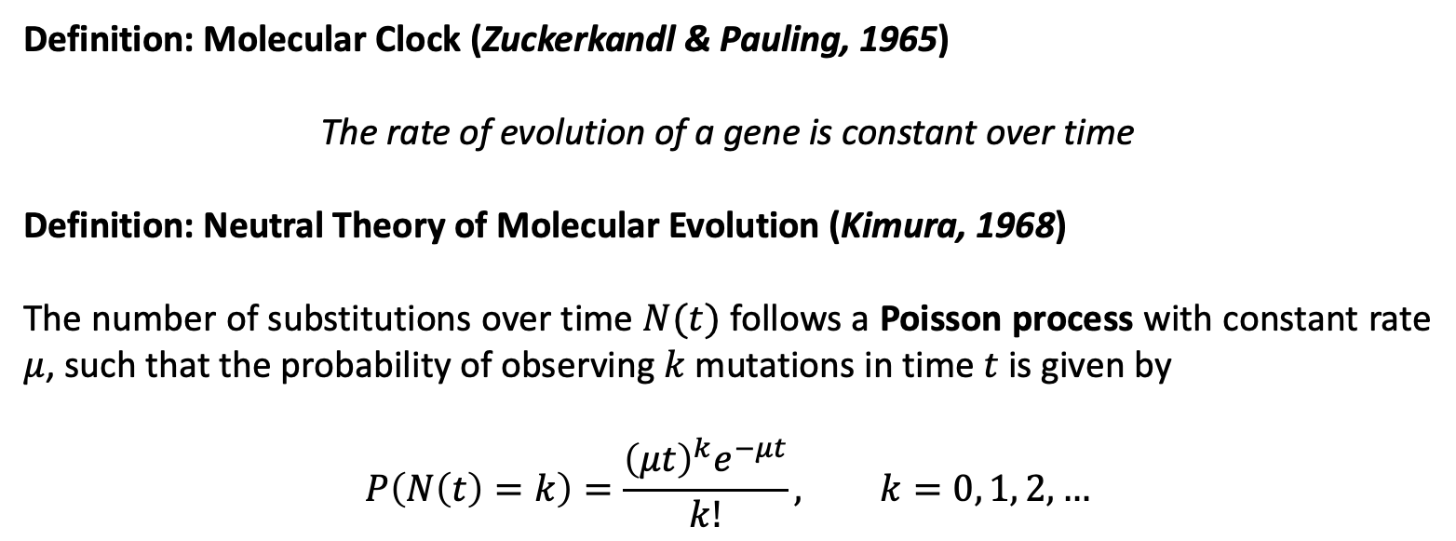
The Molecular Clock Hypothesis
Definition: Molecular Clock (Zuckerkandl & Pauling, 1965)
The rate of evolution of a gene is constant over time
Definition: Neutral Theory of Molecular Evolution (Kimura, 1968)
The number of substitutions over time $N(t)$ follows a Poisson process with constant rate $μ$, such that the probability of observing $k$ mutations in time $t$ is given by
$$P\left(N\left(t\right)=k\right)=\frac{{\left(μt\right)}^{k}e^{−μt}}{k!}, k=0, 1, 2, …$$
Stoch. Dyn. Mod. of evolving gene expression programs
Valencia, July 25th, 2025
Lucas Goiriz, (CSIC – UV; UPV)

Slide 20
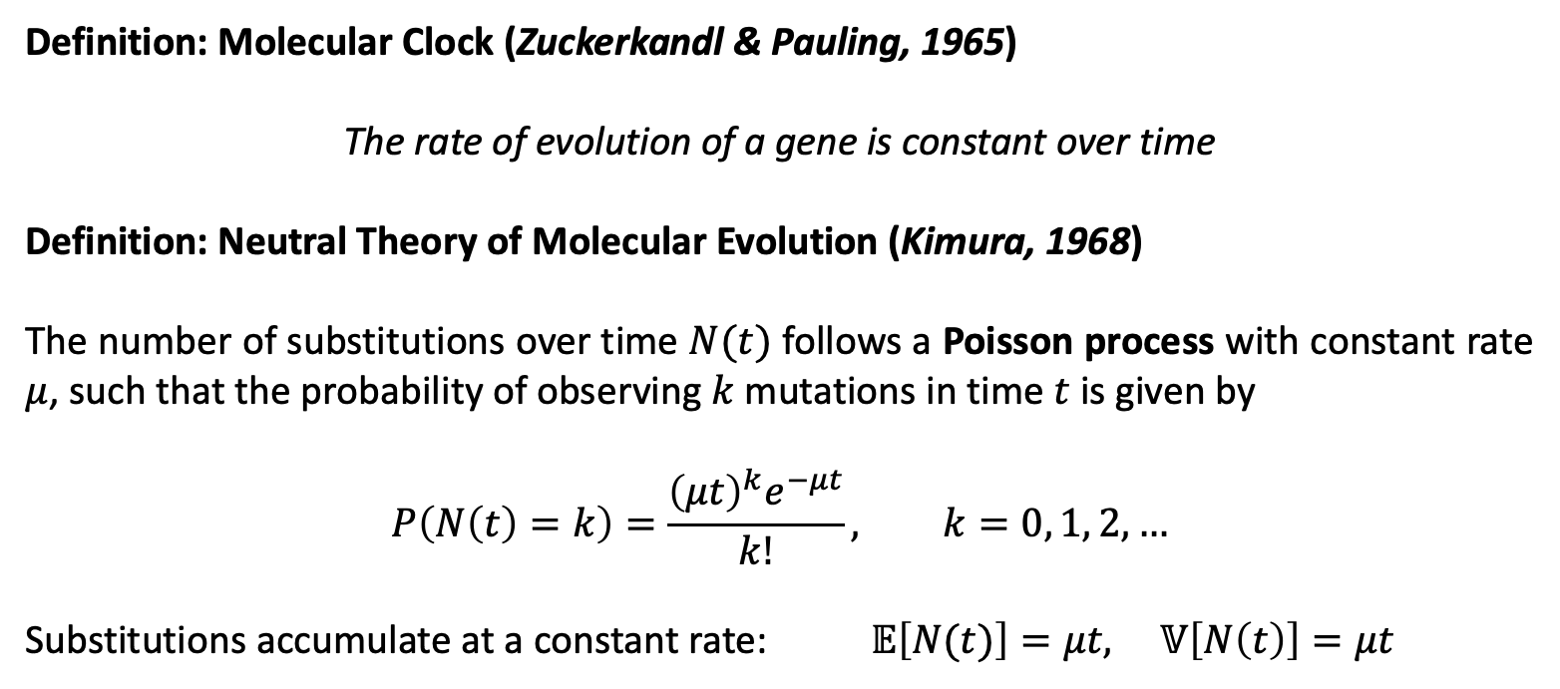
The Molecular Clock Hypothesis
Definition: Molecular Clock (Zuckerkandl & Pauling, 1965)
The rate of evolution of a gene is constant over time
Definition: Neutral Theory of Molecular Evolution (Kimura, 1968)
The number of substitutions over time $N(t)$ follows a Poisson process with constant rate $μ$, such that the probability of observing $k$ mutations in time $t$ is given by
$$P\left(N\left(t\right)=k\right)=\frac{{\left(μt\right)}^{k}e^{−μt}}{k!}, k=0, 1, 2, …$$
Substitutions accumulate at a constant rate: $𝔼\left[N(t)\right]=μt, 𝕍\left[N\left(t\right)\right]=μt$
Stoch. Dyn. Mod. of evolving gene expression programs
Valencia, July 25th, 2025
Lucas Goiriz, (CSIC – UV; UPV)

Slide 21
The Molecular Clock Hypothesis
Definition: Molecular Clock (Zuckerkandl & Pauling, 1965)
The rate of evolution of a gene is constant over time
Definition: Neutral Theory of Molecular Evolution (Kimura, 1968)
The number of substitutions over time $N(t)$ follows a Poisson process with constant rate $μ$, such that the probability of observing $k$ mutations in time $t$ is given by
$$P\left(N\left(t\right)=k\right)=\frac{{\left(μt\right)}^{k}e^{−μt}}{k!}, k=0, 1, 2, …$$
Substitutions accumulate at a constant rate: $𝔼\left[N(t)\right]=μt, 𝕍\left[N\left(t\right)\right]=μt$
Observed overdispersion challenges this assumption
Stoch. Dyn. Mod. of evolving gene expression programs
Valencia, July 25th, 2025
Lucas Goiriz, (CSIC – UV; UPV)

Slide 22
The Molecular Clock Hypothesis
Definition: Molecular Clock (Zuckerkandl & Pauling, 1965)
The rate of evolution of a gene is constant over time
Definition: Neutral Theory of Molecular Evolution (Kimura, 1968)
The number of substitutions over time $N(t)$ follows a Poisson process with constant rate $μ$, such that the probability of observing $k$ mutations in time $t$ is given by
$$P\left(N\left(t\right)=k\right)=\frac{{\left(μt\right)}^{k}e^{−μt}}{k!}, k=0, 1, 2, …$$
Substitutions accumulate at a constant rate: $𝔼\left[N(t)\right]=μt, 𝕍\left[N\left(t\right)\right]=μt$
Observed overdispersion challenges this assumption
SARS-CoV-2: ideal model to test these deviations
Stoch. Dyn. Mod. of evolving gene expression programs
Valencia, July 25th, 2025
Lucas Goiriz, (CSIC – UV; UPV)

Slide 23
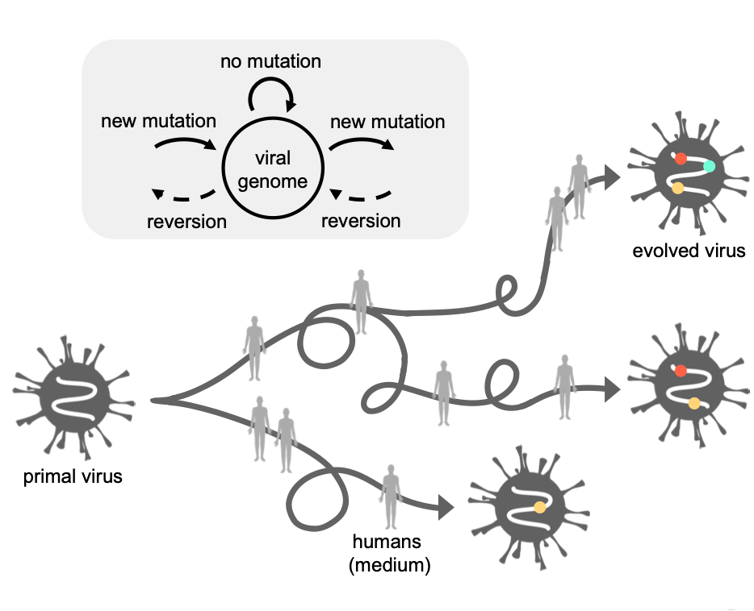
SARS-CoV-2 as a “Natural” Evolutionary Experiment
10 million SARS-CoV-2 genomes sequenced globally (May 2022)
Stoch. Dyn. Mod. of evolving gene expression programs
Valencia, July 25th, 2025
Lucas Goiriz, (CSIC – UV; UPV)
Notes:
The unprecedented global response to the COVID-19 pandemic led to an extensive effort in sequencing SARS-CoV-2 genomes in real time. With over 10 million sequences available, including a high-resolution dataset from the United Kingdom, researchers were presented with an extraordinary opportunity: to monitor viral evolution as it unfolded in nature.
This real-time surveillance enabled the study of key epidemiological and evolutionary processes — from identifying variants of concern and their characteristic mutations, to tracking spatiotemporal dynamics of variant spread, assessing containment strategies, and even detecting co-infections and recombinant strains.
Importantly, the mutation spectrum of SARS-CoV-2 exhibited marked asymmetries (e.g., prevalence of C>U and G>U substitutions), and purifying selection appeared to dominate, with some sites showing adaptive changes. Despite this wealth of observational data, a mathematical characterization of the underlying stochastic dynamics — especially the variance and scaling behavior of mutations over time — remained lacking. This chapter leverages the available data to construct a non-phylogenetic, probabilistic framework to model these evolutionary motions, challenging the standard Poissonian expectations of the molecular clock.

Slide 24
SARS-CoV-2 as a “Natural” Evolutionary Experiment
10 million SARS-CoV-2 genomes sequenced globally (May 2022)
Variant emergence and transitions:
Stoch. Dyn. Mod. of evolving gene expression programs
Valencia, July 25th, 2025
Lucas Goiriz, (CSIC – UV; UPV)

Slide 25
SARS-CoV-2 as a “Natural” Evolutionary Experiment
10 million SARS-CoV-2 genomes sequenced globally (May 2022)
Variant emergence and transitions:
Mutation accumulation rates
Stoch. Dyn. Mod. of evolving gene expression programs
Valencia, July 25th, 2025
Lucas Goiriz, (CSIC – UV; UPV)

Slide 26
SARS-CoV-2 as a “Natural” Evolutionary Experiment
10 million SARS-CoV-2 genomes sequenced globally (May 2022)
Variant emergence and transitions:
Mutation accumulation rates
Transmission dynamics and selective pressures
Stoch. Dyn. Mod. of evolving gene expression programs
Valencia, July 25th, 2025
Lucas Goiriz, (CSIC – UV; UPV)

Slide 27
SARS-CoV-2 as a “Natural” Evolutionary Experiment
10 million SARS-CoV-2 genomes sequenced globally (May 2022)
Variant emergence and transitions:
Mutation accumulation rates
Transmission dynamics and selective pressures
Ideal system to probe evolutionary motion statistically
Stoch. Dyn. Mod. of evolving gene expression programs
Valencia, July 25th, 2025
Lucas Goiriz, (CSIC – UV; UPV)

Slide 28
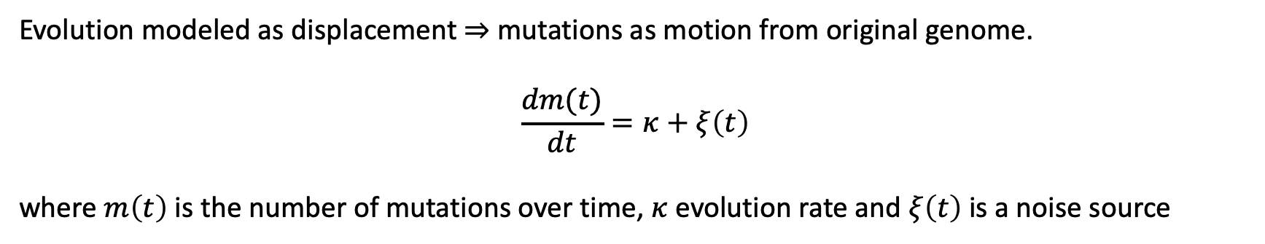
Modeling Viral Evolution as Stochastic Motion
Evolution modeled as displacement $⇒$ mutations as motion from original genome.
$$\frac{dm(t)}{dt}=κ+ξ\left(t\right)$$
where $m\left(t\right)$ is the number of mutations over time, $κ$ evolution rate and $ξ\left(t\right)$ is a noise source
Stoch. Dyn. Mod. of evolving gene expression programs
Valencia, July 25th, 2025
Lucas Goiriz, (CSIC – UV; UPV)
Notes:
We modeled SARS-CoV-2 evolution as a stochastic motion, conceptualizing the accumulation of mutations over time as the displacement of a viral "particle" in sequence space from its origin. This framework is formalized using a continuous-time stochastic differential equation:
𝑑𝑚(𝑡)/𝑑𝑡=k+xi(𝑡)
Where m(t) represents the total number of mutations accumulated by the viral genome at time t, k is the evolution rate (which may be time- or variant-dependent), and xi(t) is a noise term capturing fluctuations in the mutation process. This model enables a purely probabilistic treatment of viral evolution, independent of any phylogenetic reconstruction.
The motivation is to characterize the mean and variance (or mean squared displacement) of this evolutionary process. By doing so, we aim to distinguish between different types of diffusion-like behavior — such as Brownian, subdiffusive, or superdiffusive motion — and to determine whether the molecular clock holds uniformly or varies with SARS-CoV-2 variants and epidemiological shifts.
This model provides the foundation for subsequent analyses of viral mutation dynamics across multiple lineages.
Using exclusively viral sequences originating in the UK (due to their coverage and sequencing quality), UK. Using weekly time bins, we found a macroscopic evolution rate of:
k = 0.62 wk^-1
This value was derived from a linear regression of mean mutation counts over time and showed high correlation (Pearson's, P<10^-4). We also analyzed mutations by type: non-coding, synonymous, non-synonymous, and indels. Importantly, we computed the dN/dS ratio — a classic metric to infer selective pressure — which fluctuated around 1. This pattern suggests purifying selection predominated, consistent with a regime where non-synonymous mutations are being weeded out more often than retained.
Together, these results indicate that while the molecular clock framework fits the early average dynamics, it fails to capture the bursts and heterogeneity associated with variant transitions.

Slide 29
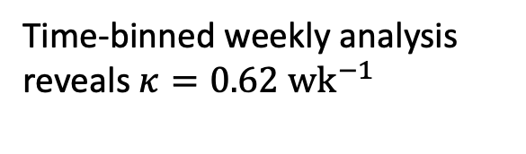
Modeling Viral Evolution as Stochastic Motion
Evolution modeled as displacement $⇒$ mutations as motion from original genome.
$$\frac{dm(t)}{dt}=κ+ξ\left(t\right)$$
where $m\left(t\right)$ is the number of mutations over time, $κ$ evolution rate and $ξ\left(t\right)$ is a noise source
Time-binned weekly analysis reveals $κ=0.62 {wk}^{−1}$
Stoch. Dyn. Mod. of evolving gene expression programs
Valencia, July 25th, 2025
Lucas Goiriz, (CSIC – UV; UPV)

Slide 30
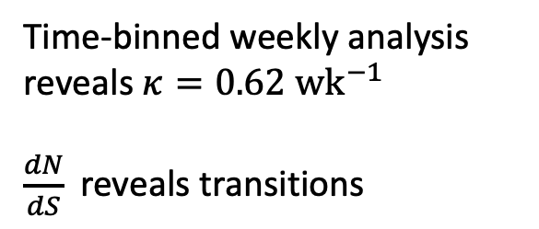
Modeling Viral Evolution as Stochastic Motion
Evolution modeled as displacement $⇒$ mutations as motion from original genome.
$$\frac{dm(t)}{dt}=κ+ξ\left(t\right)$$
where $m\left(t\right)$ is the number of mutations over time, $κ$ evolution rate and $ξ\left(t\right)$ is a noise source
Time-binned weekly analysis reveals $κ=0.62 {wk}^{−1}$
$\frac{dN}{dS}$ reveals transitions
Stoch. Dyn. Mod. of evolving gene expression programs
Valencia, July 25th, 2025
Lucas Goiriz, (CSIC – UV; UPV)

Slide 31
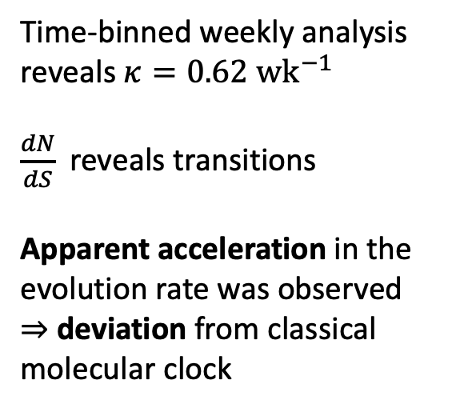
Modeling Viral Evolution as Stochastic Motion
Evolution modeled as displacement $⇒$ mutations as motion from original genome.
$$\frac{dm(t)}{dt}=κ+ξ\left(t\right)$$
where $m\left(t\right)$ is the number of mutations over time, $κ$ evolution rate and $ξ\left(t\right)$ is a noise source
Time-binned weekly analysis reveals $κ=0.62 {wk}^{−1}$
$\frac{dN}{dS}$ reveals transitions
Apparent acceleration in the evolution rate was observed
$⇒$ deviation from classical molecular clock
Stoch. Dyn. Mod. of evolving gene expression programs
Valencia, July 25th, 2025
Lucas Goiriz, (CSIC – UV; UPV)

Slide 32
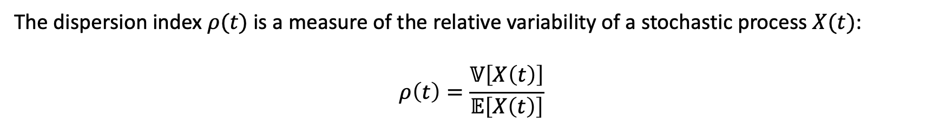
Mutation Variance and Dispersion Index
The dispersion index $ρ(t)$ is a measure of the relative variability of a stochastic process $X(t)$:
$$ρ\left(t\right)=\frac{𝕍\left[X\left(t\right)\right]}{𝔼\left[X\left(t\right)\right]}$$
Stoch. Dyn. Mod. of evolving gene expression programs
Valencia, July 25th, 2025
Lucas Goiriz, (CSIC – UV; UPV)
Notes:
Beyond the mean mutation rate, a central focus of the study is the variance in the number of accumulated mutations — an often overlooked but critical aspect of stochastic evolutionary models. To quantify this, the authors computed the dispersion index, denoted rho(t), defined as:
rho(t) = V[m(t)] / E[m(t)]
This ratio compares the variance to the mean and is expected to equal 1 under a Poisson process, which characterizes classical molecular clock models.
However, the study found that the dispersion index was consistently less than 1, indicating sub-Poissonian behavior. This means the variability in mutations was lower than predicted by a Poisson model — suggesting some form of constraint or structure in the evolutionary process.

Slide 33
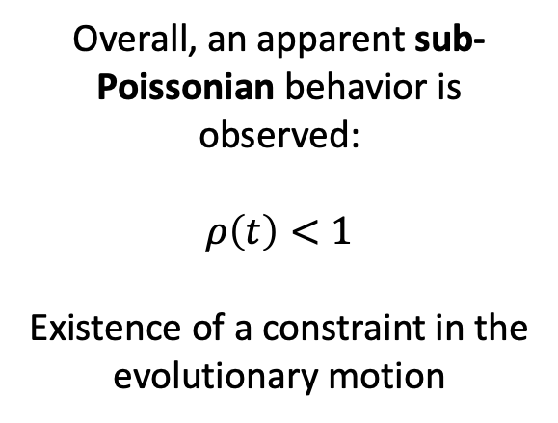
Mutation Variance and Dispersion Index
The dispersion index $ρ(t)$ is a measure of the relative variability of a stochastic process $X(t)$:
$$ρ\left(t\right)=\frac{𝕍\left[X\left(t\right)\right]}{𝔼\left[X\left(t\right)\right]}$$
Overall, an apparent sub-Poissonian behavior is observed:
$$ρ\left(t\right)<1$$
Existence of a constraint in the evolutionary motion
Stoch. Dyn. Mod. of evolving gene expression programs
Valencia, July 25th, 2025
Lucas Goiriz, (CSIC – UV; UPV)

Slide 34
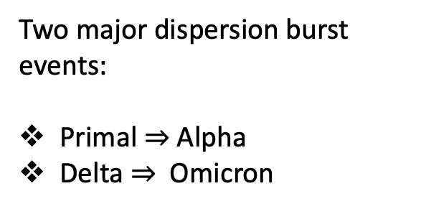
Dispersion Bursts
Two major dispersion burst events:
Primal $⇒$ Alpha
Delta $⇒$ Omicron
Stoch. Dyn. Mod. of evolving gene expression programs
Valencia, July 25th, 2025
Lucas Goiriz, (CSIC – UV; UPV)
Notes:
Interestingly, the analysis revealed two major bursts in dispersion, corresponding to the emergence of the Alpha and Omicron variants. These transitions introduced bimodal mutation distributions, indicating the coexistence of divergent genotypes during periods of variant replacement. Invading genotypes carried ~15-20 more mutations, Alpha to Delta transition showed minimal dispersion (similar mutation counts).
This behavior challenges the assumption of uniform random mutation accumulation and highlights the role of population dynamics in shaping mutation variance.
These findings point toward a more nuanced, variant-dependent model of viral evolution.

Slide 35
Dispersion Bursts
Two major dispersion burst events:
Primal $⇒$ Alpha
Delta $⇒$ Omicron
Bimodal mutation distributions $⇒$ coexistence of divergent genotypes
Stoch. Dyn. Mod. of evolving gene expression programs
Valencia, July 25th, 2025
Lucas Goiriz, (CSIC – UV; UPV)

Slide 36
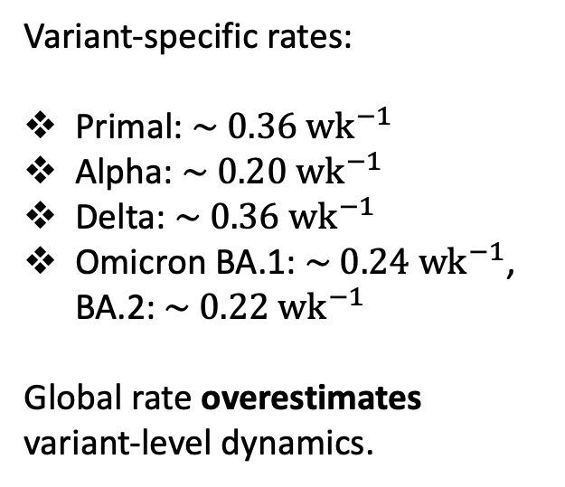
Variant-Specific Mutation Dynamics
Per-variant analysis: Primal, Alpha, Delta & Omicron
Variant-specific rates:
Primal: $\sim 0.36 {wk}^{−1}$
Alpha: $\sim 0.20 {wk}^{−1}$
Delta: $\sim 0.36 {wk}^{−1}$
Omicron BA.1: $\sim 0.24 {wk}^{−1}$, BA.2: $\sim 0.22 {wk}^{−1}$
Global rate overestimates variant-level dynamics.
Stoch. Dyn. Mod. of evolving gene expression programs
Valencia, July 25th, 2025
Lucas Goiriz, (CSIC – UV; UPV)
Notes:
To investigate whether the apparent overdispersion at the global level might mask variant-specific dynamics, the authors conducted an independent analysis for each of the major SARS-CoV-2 variants: Primal, Alpha, Delta, and the two major Omicron lineages — BA.1 and BA.2.
They found that the evolution rate within each variant was significantly lower than the global macroscopic rate of 0.62 wk^-1. Specifically:
Primal and Delta both evolved at about 0.36 wk^-1,
Alpha at 0.20 wk^-1,
Omicron BA.1 at 0.24 wk^-1,
and BA.2 at only 0.20 wk^-1.
These findings underscore a key insight: the macroscopic rate reflects not just intra-variant evolution, but also the punctuated effects of variant replacements. When variants with markedly higher mutation loads emerge, they cause jumps in the overall mutation count, artificially inflating the global rate.
This analysis supports the notion that evolutionary motion is reset with each new variant and further motivates modeling evolution as variant-dependent diffusion, rather than a single, homogeneous process.
When looking at how the dN/dS ratio — the ratio of nonsynonymous to synonymous substitutions per site — changed over time for each variant, we found a consistent downward trend across all variants. This decline was most pronounced in Delta, implying that Delta accumulated a higher proportion of synonymous (i.e., neutral) mutations over time, suggesting a less constrained, more exploratory evolutionary path.
In contrast, Primal, Alpha, and Omicron BA.1, exhibited weaker declines in dN/dS. This suggests they were under stronger functional constraints, likely due to the impact of nonsynonymous mutations being deleterious or selectively neutral but constrained.
Thus, selection pressures and stochastic motion are closely intertwined in shaping the variant-specific evolutionary trajectories.
When looking into the Variance, the observation of non-linear patterns suggests that the molecular clock hypothesis is not uniform across variants.

Slide 37
Variant-Specific Mutation Dynamics
Per-variant analysis: Primal, Alpha, Delta & Omicron
Variant-specific rates:
Primal: $\sim 0.36 {wk}^{−1}$
Alpha: $\sim 0.20 {wk}^{−1}$
Delta: $\sim 0.36 {wk}^{−1}$
Omicron BA.1: $\sim 0.24 {wk}^{−1}$, BA.2: $\sim 0.22 {wk}^{−1}$
Global rate overestimates variant-level dynamics.
Nonlinear patterns in the variance challenge the molecular clock
Stoch. Dyn. Mod. of evolving gene expression programs
Valencia, July 25th, 2025
Lucas Goiriz, (CSIC – UV; UPV)

Slide 38
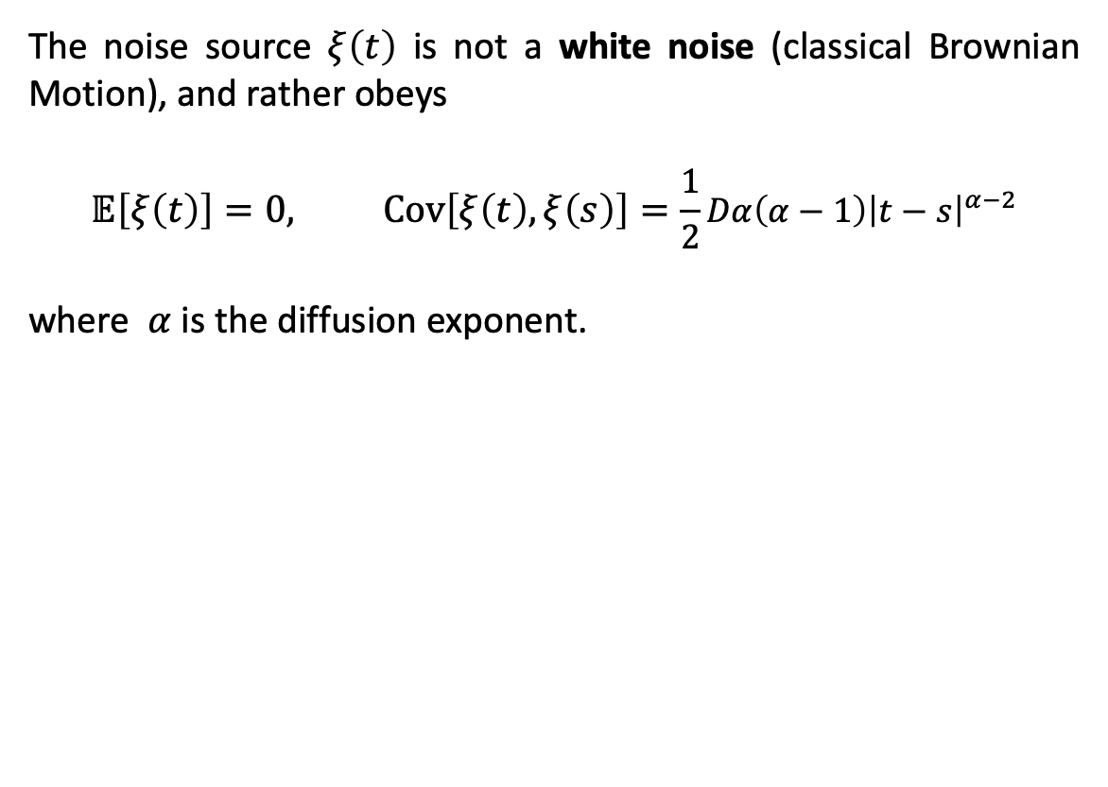
Anomalous Diffusion in Evolutionary Motion
The noise source $ξ\left(t\right)$ is not a white noise (classical Brownian Motion), and rather obeys
$$𝔼\left[ξ\left(t\right)\right]=0, Cov\left[ξ\left(t\right),ξ\left(s\right)\right]=\frac{1}{2}Dα\left(α−1\right){\left|t−s\right|}^{α−2}$$
where $α$ is the diffusion exponent.
Stoch. Dyn. Mod. of evolving gene expression programs
Valencia, July 25th, 2025
Lucas Goiriz, (CSIC – UV; UPV)
Notes:
The Poisson process models mutation accumulation as a series of discrete events, while Brownian motion provides a continuous approximation. In both models, the variance and mean scale linearly with time (dispersion index is 1). However, the empirical data often deviate from these predictions, motivating the need for more flexible models.
Anomalous diffusion is characterized by variance that scales as $t^\alpha$, where $\alpha$ can differ from 1. To achieve this definition for the Variance, we use the Fractional Brownian motion. This model provides a more accurate description of the observed evolutionary dynamics. The diffusion exponent $\alpha$ quantifies the degree of deviation from classical Brownian motion, with subdiffusion ($\alpha < 1$) and superdiffusion ($\alpha > 1$) observed in different variants. The dynamics observed differ substantially depending on the variant, suggesting long-range dependencies or structural constraints in the mutation process.
Primal, Alpha and Omicron show subdiffusive behavior — where mutations accumulate more slowly than under Brownian motion, suggesting constraint or saturation near a fitness peak.
In contrast, Delta had a diffusion exponent greater than 1, consistent with superdiffusion. This implies that Delta underwent a more exploratory and accelerated evolutionary trajectory, possibly reflecting stronger adaptive forces or looser selective constraints during its emergence.
Together, these results provide quantitative evidence that SARS-CoV-2 evolution deviates from Poissonian assumptions, and follows variant-specific stochastic regimes.

Slide 39
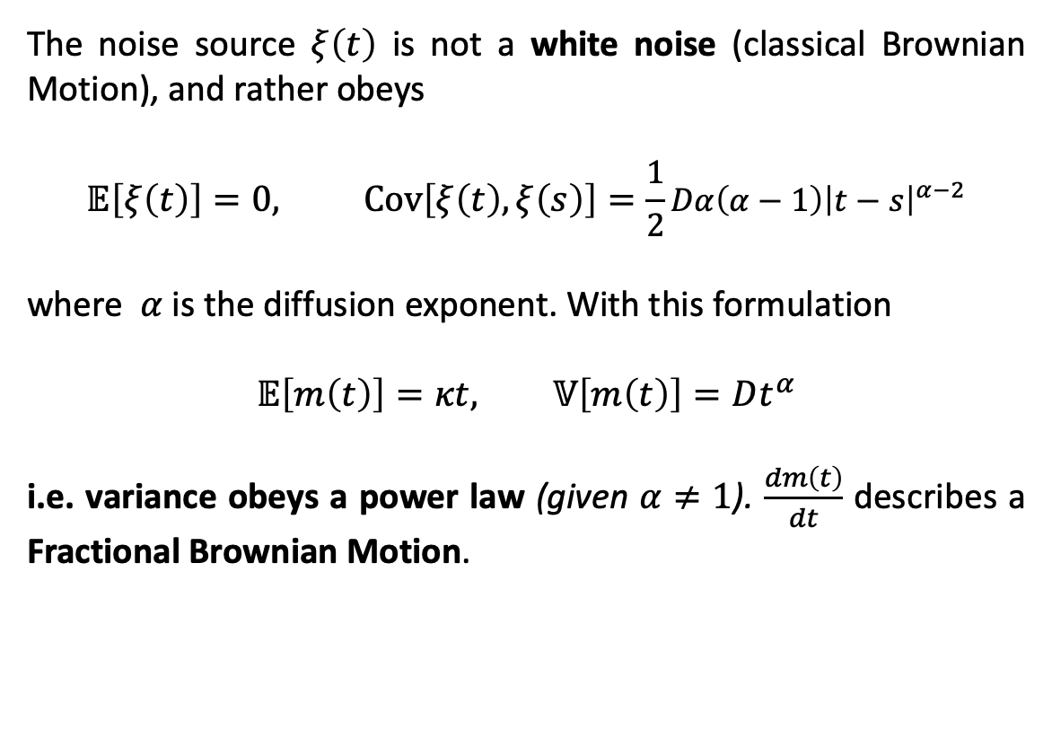
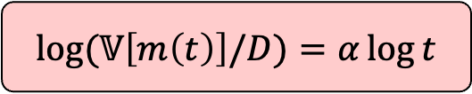
Anomalous Diffusion in Evolutionary Motion
The noise source $ξ\left(t\right)$ is not a white noise (classical Brownian Motion), and rather obeys
$$𝔼\left[ξ\left(t\right)\right]=0, Cov\left[ξ\left(t\right),ξ\left(s\right)\right]=\frac{1}{2}Dα\left(α−1\right){\left|t−s\right|}^{α−2}$$
where $α$ is the diffusion exponent. With this formulation
$$𝔼\left[m\left(t\right)\right]=κt, 𝕍\left[m\left(t\right)\right]=Dt^{α}$$
i.e. variance obeys a power law (given $α≠1$). $\frac{dm\left(t\right)}{dt}$ describes a Fractional Brownian Motion.
$$\log{(𝕍\left[m\left(t\right)\right]/D)}=α\log{t}$$
Stoch. Dyn. Mod. of evolving gene expression programs
Valencia, July 25th, 2025
Lucas Goiriz, (CSIC – UV; UPV)

Slide 40
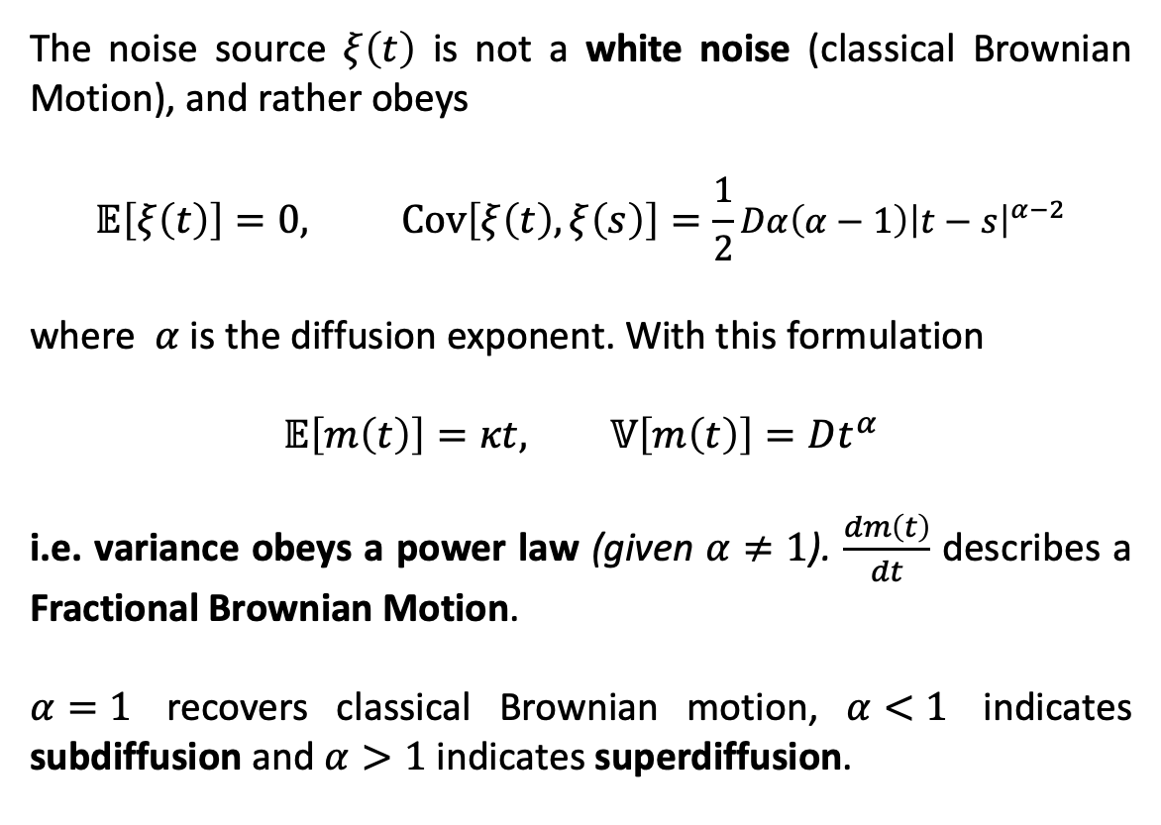
Anomalous Diffusion in Evolutionary Motion
The noise source $ξ\left(t\right)$ is not a white noise (classical Brownian Motion), and rather obeys
$$𝔼\left[ξ\left(t\right)\right]=0, Cov\left[ξ\left(t\right),ξ\left(s\right)\right]=\frac{1}{2}Dα\left(α−1\right){\left|t−s\right|}^{α−2}$$
where $α$ is the diffusion exponent. With this formulation
$$𝔼\left[m\left(t\right)\right]=κt, 𝕍\left[m\left(t\right)\right]=Dt^{α}$$
i.e. variance obeys a power law (given $α≠1$). $\frac{dm\left(t\right)}{dt}$ describes a Fractional Brownian Motion.
$α=1$ recovers classical Brownian motion, $α<1$ indicates subdiffusion and $α>1$ indicates superdiffusion.
$$\log{(𝕍\left[m\left(t\right)\right]/D)}=α\log{t}$$
Stoch. Dyn. Mod. of evolving gene expression programs
Valencia, July 25th, 2025
Lucas Goiriz, (CSIC – UV; UPV)

Slide 41
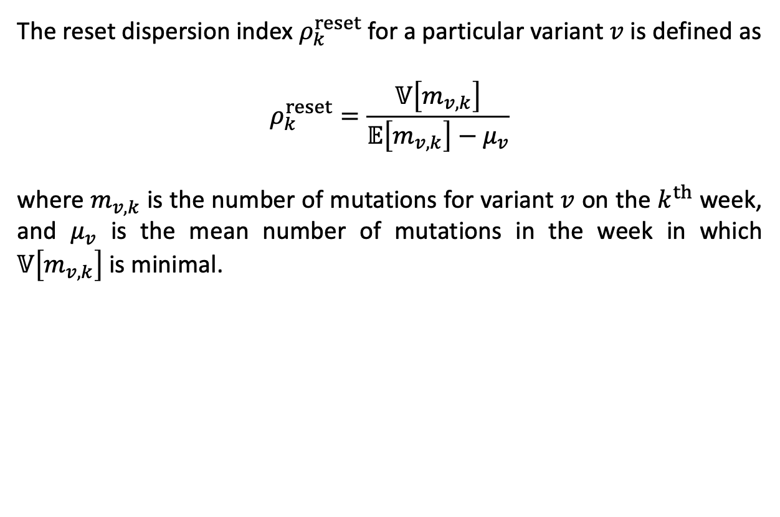
Reset Dispersion and Asymptotic Poisson Behavior
The reset dispersion index $ρ_{k}^{reset}$ for a particular variant $v$ is defined as
$$ρ_{k}^{reset}=\frac{𝕍\left[m_{v,k}\right]}{𝔼\left[m_{v,k}\right]−μ_{v}}$$
where $m_{v,k}$ is the number of mutations for variant $v$ on the $k^{th}$ week, and $μ_{v}$ is the mean number of mutations in the week in which $𝕍\left[m_{v,k}\right]$ is minimal.
Stoch. Dyn. Mod. of evolving gene expression programs
Valencia, July 25th, 2025
Lucas Goiriz, (CSIC – UV; UPV)
Notes:
To further refine the model and account for the discontinuities introduced by variant replacement, the authors introduced the concept of the reset dispersion index, denoted rho_reset(t). This metric calculates the ratio of variance to mean mutation count since the appearance of a specific variant, resetting the evolutionary clock at each major variant's emergence:
rho_reset(t) = V[m_v(t)] / E[m_v(t)] - mu_v
Here, m_v(t) is the number of mutations in variant v at time t, and mu_v is the mutation count at the time of variant introduction — i.e., the new origin.
When plotted over time, this index converges toward 1, implying that the mutation dynamics within individual variants tend to behave Poissonian at long time scales. This suggests that subdiffusion or superdiffusion is transient, occurring during variant transitions or early spread, and settles into a more homogeneous, memoryless process once the variant becomes established.
This finding underscores the importance of modeling variant turnover explicitly, and illustrates that a global molecular clock is insufficient to capture the true multi-phase dynamics of viral evolution.

Slide 42

Reset Dispersion and Asymptotic Poisson Behavior
The reset dispersion index $ρ_{k}^{reset}$ for a particular variant $v$ is defined as
$$ρ_{k}^{reset}=\frac{𝕍\left[m_{v,k}\right]}{𝔼\left[m_{v,k}\right]−μ_{v}}$$
where $m_{v,k}$ is the number of mutations for variant $v$ on the $k^{th}$ week, and $μ_{v}$ is the mean number of mutations in the week in which $𝕍\left[m_{v,k}\right]$ is minimal.
Resets mutation count at variant emergence
When $k→∞, ρ_{k}^{reset}→1 ⇒ \text{asymptotic} \text{Poissonian} \text{behavior} \text{within} \text{variants}$
Stoch. Dyn. Mod. of evolving gene expression programs
Valencia, July 25th, 2025
Lucas Goiriz, (CSIC – UV; UPV)

Slide 43
Closing Remarks
1. Challenges the molecular clock paradigm: Viral evolution is non-uniform and variant-dependent, departing from classical Poisson models.
2. Reveals anomalous diffusion: Evolutionary dynamics show nonlinear mutation scaling and overdispersion tied to selection and population shifts.
3. Calls for refined models: Highlights the need for stochastic, variant-aware frameworks to better capture real-time viral evolution.
Stoch. Dyn. Mod. of evolving gene expression programs
Valencia, July 25th, 2025
Lucas Goiriz, (CSIC – UV; UPV)

Slide 44
Chapter 4: PyEvoMotion: a software to perform the temporal statistical analysis of genome evolution
Goiriz L, Rodrigo G. (2025)
PyEvoMotion: a Python tool for population-based time-course analysis of genome evolution
Bioinformatics. (Under Review)
Stoch. Dyn. Mod. of evolving gene expression programs
Valencia, July 25th, 2025
Lucas Goiriz, (CSIC – UV; UPV)
Notes:
Let’s step into Chapter 4, where we abstract the results into a software.

Slide 45

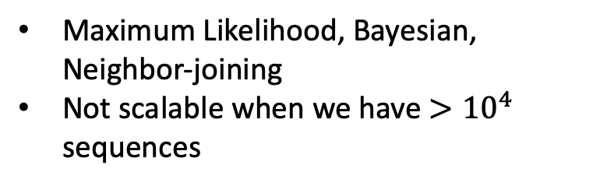
Phylogeny vs. Statistical Analysis
Classical Phylogenetic Methods
Maximum Likelihood, Bayesian, Neighbor-joining
Not scalable when we have $>{10}^{4}$ sequences
Stoch. Dyn. Mod. of evolving gene expression programs
Valencia, July 25th, 2025
Lucas Goiriz, (CSIC – UV; UPV)
Notes:
Diagrama de fases: - statistical approaches (PyEVoMotion) - maximum parsimony phylogenetics (MAPLE) - maximum likelihood phylogenetics (BEAST)
Relacionado con numero de secuencias disponibles

Slide 46
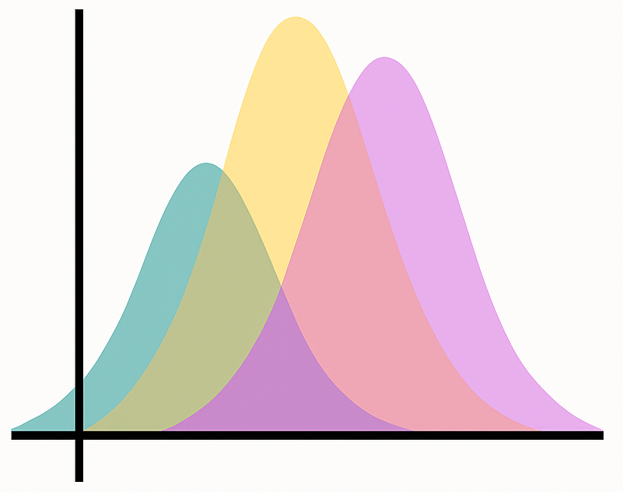
Phylogeny vs. Statistical Analysis
Classical Phylogenetic Methods
Statistical Properties in Data
Maximum Likelihood, Bayesian, Neighbor-joining
Not scalable when we have $>{10}^{4}$ sequences
Captures probabilistic structure and patterns
Scales up several orders of magnitude
Stoch. Dyn. Mod. of evolving gene expression programs
Valencia, July 25th, 2025
Lucas Goiriz, (CSIC – UV; UPV)
Notes:
Diagrama de fases: - statistical approaches (PyEVoMotion) - maximum parsimony phylogenetics (MAPLE) - maximum likelihood phylogenetics (BEAST)
Relacionado con numero de secuencias disponibles

Slide 47
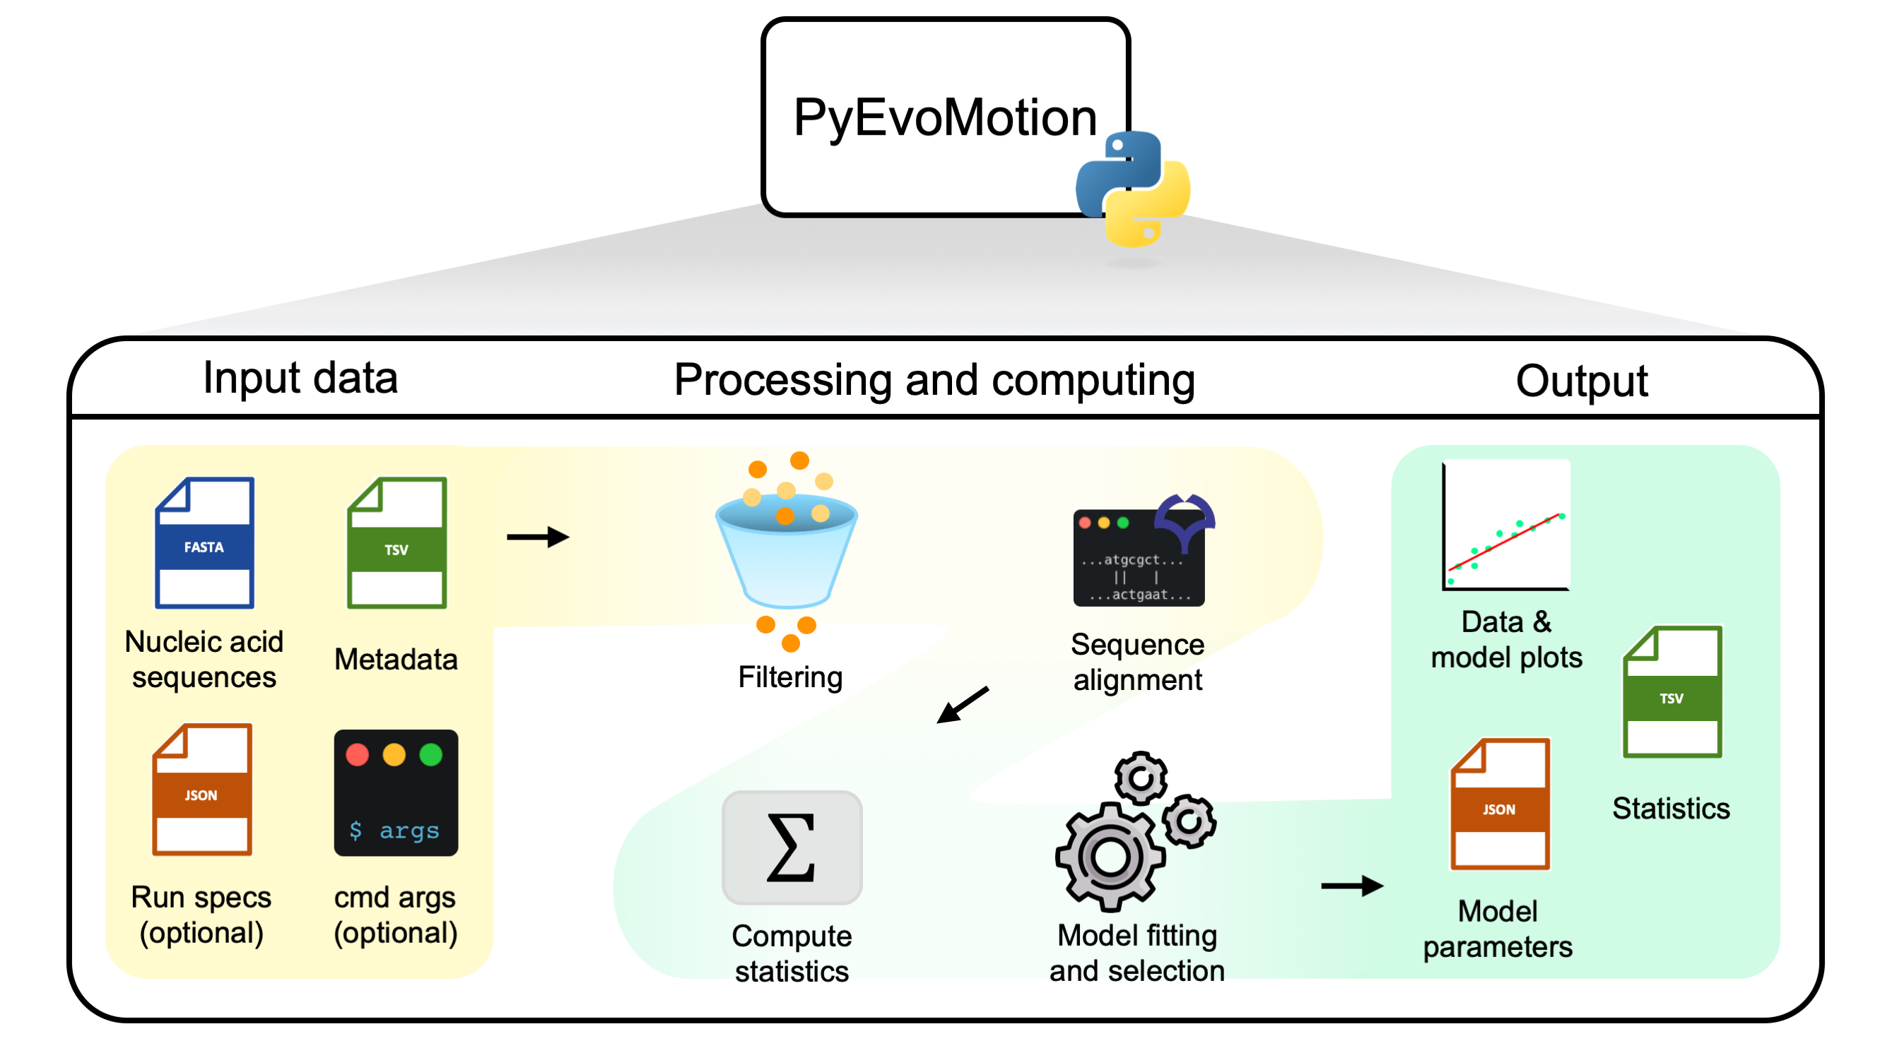
Workflow and Data Requirements
Inputs:
.fasta file (genomic sequences)
.tsv file (metadata, including collection dates)
Configurable options (time intervals, filter, mutations types)
Output:
Graphical plots
Statisctics (.tsv, .json)
Stoch. Dyn. Mod. of evolving gene expression programs
Valencia, July 25th, 2025
Lucas Goiriz, (CSIC – UV; UPV)

Slide 48
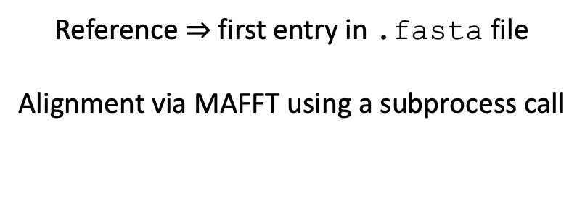
Sequence Alignment and Mutation Statistics
Alignment
Reference $⇒$ first entry in .fasta file
Alignment via MAFFT using a subprocess call
Stoch. Dyn. Mod. of evolving gene expression programs
Valencia, July 25th, 2025
Lucas Goiriz, (CSIC – UV; UPV)
Notes:
Diagrama de fases: - statistical approaches (PyEVoMotion) - maximum parsimony phylogenetics (MAPLE) - maximum likelihood phylogenetics (BEAST)
Relacionado con numero de secuencias disponibles

Slide 49
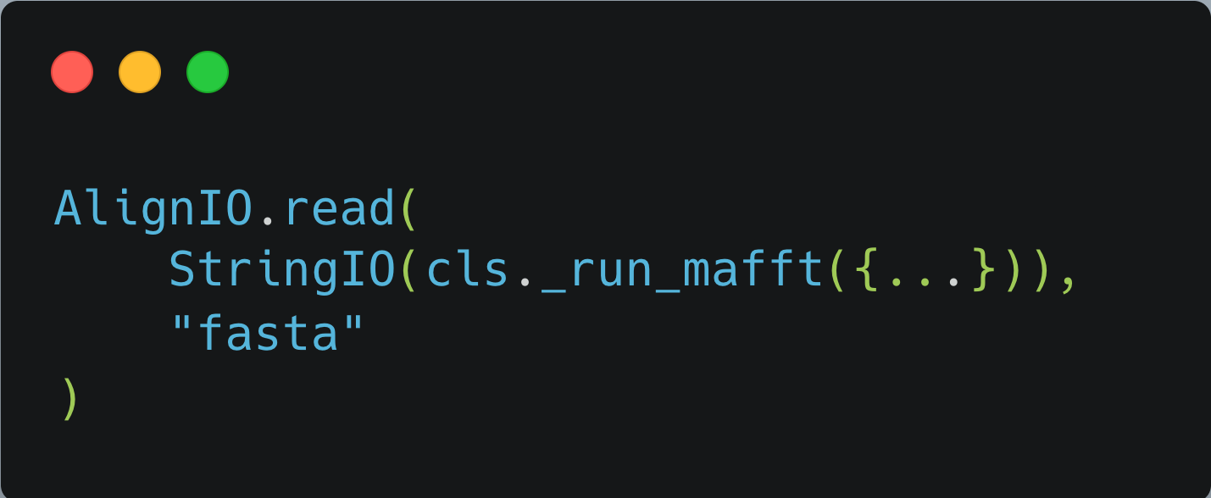
Sequence Alignment and Mutation Statistics
Alignment
Reference $⇒$ first entry in .fasta file
Alignment via MAFFT using a subprocess call
High throughput parsing via BioPython
Stoch. Dyn. Mod. of evolving gene expression programs
Valencia, July 25th, 2025
Lucas Goiriz, (CSIC – UV; UPV)
Notes:
Diagrama de fases: - statistical approaches (PyEVoMotion) - maximum parsimony phylogenetics (MAPLE) - maximum likelihood phylogenetics (BEAST)
Relacionado con numero de secuencias disponibles

Slide 50
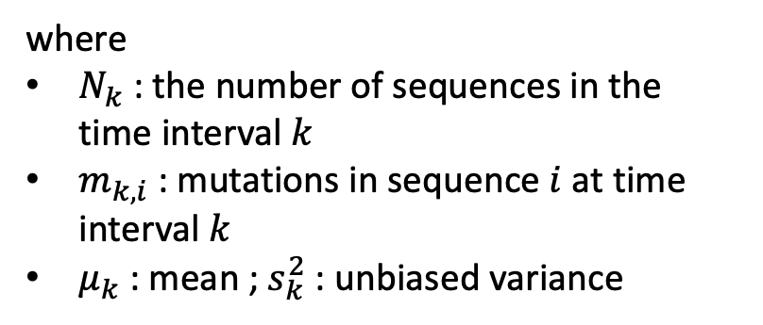
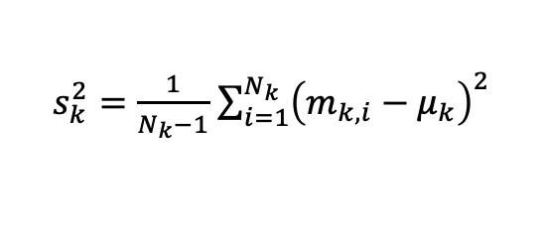
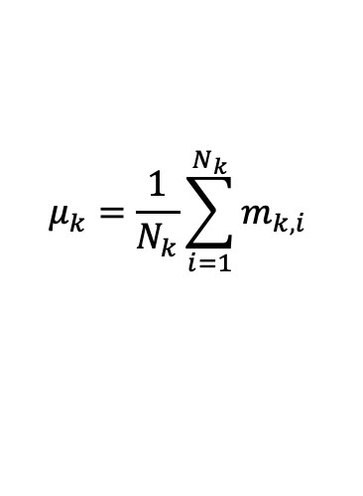
Sequence Alignment and Mutation Statistics
Alignment
Mutation Statistics per time interval
Reference $⇒$ first entry in .fasta file
Alignment via MAFFT using a subprocess call
$$μ_{k}=\frac{1}{N_{k}}\sum_{i=1}^{N_{k}}{m_{k,i}}$$
$s_{k}^{2}=\frac{1}{N_{k}−1}$ $\sum_{i=1}^{N_{k}}{{\left(m_{k,i}−μ_{k}\right)}^{2}}$
where
$N_{k}$ : the number of sequences in the time interval $k$
$m_{k,i}$ : mutations in sequence $i$ at time interval $k$
$μ_{k}$ : mean ; $s_{k}^{2}$ : unbiased variance
High throughput parsing via BioPython
Stoch. Dyn. Mod. of evolving gene expression programs
Valencia, July 25th, 2025
Lucas Goiriz, (CSIC – UV; UPV)
Notes:
Diagrama de fases: - statistical approaches (PyEVoMotion) - maximum parsimony phylogenetics (MAPLE) - maximum likelihood phylogenetics (BEAST)
Relacionado con numero de secuencias disponibles

Slide 51
Sequence Alignment and Mutation Statistics
Alignment
Mutation Statistics per time interval
Reference $⇒$ first entry in .fasta file
Alignment via MAFFT using a subprocess call
$$μ_{k}=\frac{1}{N_{k}}\sum_{i=1}^{N_{k}}{m_{k,i}}$$
$s_{k}^{2}=\frac{1}{N_{k}−1}$ $\sum_{i=1}^{N_{k}}{{\left(m_{k,i}−μ_{k}\right)}^{2}}$
where
$N_{k}$ : the number of sequences in the time interval $k$
$m_{k,i}$ : mutations in sequence $i$ at time interval $k$
$μ_{k}$ : mean ; $s_{k}^{2}$ : unbiased variance
High throughput parsing via BioPython
Used for model fitting
Stoch. Dyn. Mod. of evolving gene expression programs
Valencia, July 25th, 2025
Lucas Goiriz, (CSIC – UV; UPV)
Notes:
Diagrama de fases: - statistical approaches (PyEVoMotion) - maximum parsimony phylogenetics (MAPLE) - maximum likelihood phylogenetics (BEAST)
Relacionado con numero de secuencias disponibles

Slide 52
Fitting Molecular Clock Models
Variance fitting to model: rescaling ($s_{k}^{2}→s_{k}^{2}−s_{0}^{2}$) and time shifting ($t_{0}=0$)
Stoch. Dyn. Mod. of evolving gene expression programs
Valencia, July 25th, 2025
Lucas Goiriz, (CSIC – UV; UPV)
Notes:
Diagrama de fases: - statistical approaches (PyEVoMotion) - maximum parsimony phylogenetics (MAPLE) - maximum likelihood phylogenetics (BEAST)
Relacionado con numero de secuencias disponibles

Slide 53



Fitting Molecular Clock Models
Variance fitting to model: rescaling ($s_{k}^{2}→s_{k}^{2}−s_{0}^{2}$) and time shifting ($t_{0}=0$)
Classical Brownian Motion
$$𝕍\left[m\left(t\right)\right]∝t⇒𝕍\left[m\left(t\right)\right]=Dt$$
Used as null model
Fractional Brownian Motion
$$𝕍\left[m\left(t\right)\right]∝t^{α}⇒𝕍\left[m\left(t\right)\right]=Dt^{α}$$
Used as challenging model
Null model is recovered by setting $α=1$
Stoch. Dyn. Mod. of evolving gene expression programs
Valencia, July 25th, 2025
Lucas Goiriz, (CSIC – UV; UPV)
Notes:
Diagrama de fases: - statistical approaches (PyEVoMotion) - maximum parsimony phylogenetics (MAPLE) - maximum likelihood phylogenetics (BEAST)
Relacionado con numero de secuencias disponibles

Slide 54
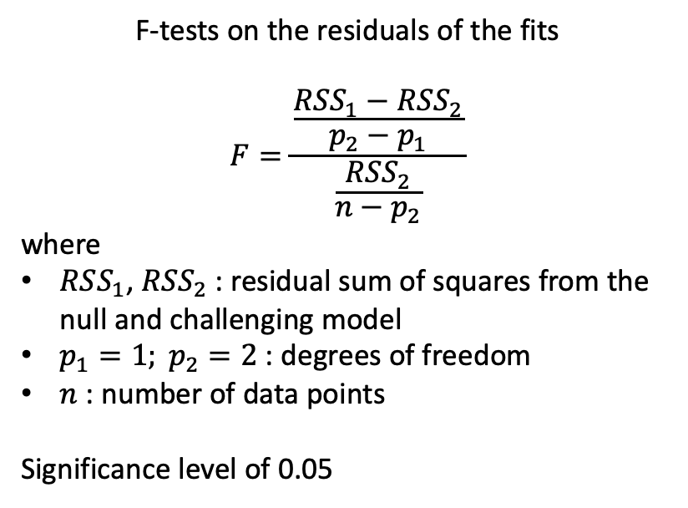
Fitting Molecular Clock Models
Variance fitting to model: rescaling ($s_{k}^{2}→s_{k}^{2}−s_{0}^{2}$) and time shifting ($t_{0}=0$)
Classical Brownian Motion
Model Selection
$$𝕍\left[m\left(t\right)\right]∝t⇒𝕍\left[m\left(t\right)\right]=Dt$$
Used as null model
F-tests on the residuals of the fits
$$F=\frac{\frac{RSS_{1}−RSS_{2}}{p_{2}−p_{1}}}{\frac{RSS_{2}}{n−p_{2}}}$$
where
$RSS_{1}$, $RSS_{2}$ : residual sum of squares from the null and challenging model
$p_{1}=1; p_{2}=2$ : degrees of freedom
$n$ : number of data points
Significance level of 0.05
Fractional Brownian Motion
$$𝕍\left[m\left(t\right)\right]∝t^{α}⇒𝕍\left[m\left(t\right)\right]=Dt^{α}$$
Used as challenging model
Null model is recovered by setting $α=1$
Stoch. Dyn. Mod. of evolving gene expression programs
Valencia, July 25th, 2025
Lucas Goiriz, (CSIC – UV; UPV)
Notes:
Diagrama de fases: - statistical approaches (PyEVoMotion) - maximum parsimony phylogenetics (MAPLE) - maximum likelihood phylogenetics (BEAST)
Relacionado con numero de secuencias disponibles

Slide 55
Customizability
Customizable targeted analysis available
Independent mutation processing
Analysis can be tailored to consider all mutations, only substitutions or only indels
Stoch. Dyn. Mod. of evolving gene expression programs
Valencia, July 25th, 2025
Lucas Goiriz, (CSIC – UV; UPV)
Notes:
Diagrama de fases: - statistical approaches (PyEVoMotion) - maximum parsimony phylogenetics (MAPLE) - maximum likelihood phylogenetics (BEAST)
Relacionado con numero de secuencias disponibles

Slide 56
Customizability
Customizable targeted analysis available
Independent mutation processing
Analysis can be tailored to consider all mutations, only substitutions or only indels
Specific Genomic region targeting
Analysis can be tailored to specific genomic regions (genes, intragenic regions, chromosomes)
Allows observation of particular intra-genome evolutionary dynamics
Stoch. Dyn. Mod. of evolving gene expression programs
Valencia, July 25th, 2025
Lucas Goiriz, (CSIC – UV; UPV)
Notes:
Diagrama de fases: - statistical approaches (PyEVoMotion) - maximum parsimony phylogenetics (MAPLE) - maximum likelihood phylogenetics (BEAST)
Relacionado con numero de secuencias disponibles

Slide 57
Customizability
Customizable targeted analysis available
Independent mutation processing
Time window customization
Analysis can be tailored to consider all mutations, only substitutions or only indels
Allows controlling the resolution of the evolutionary process
Useful to asses dynamics among entities with distinct replication times
Specific Genomic region targeting
Analysis can be tailored to specific genomic regions (genes, intragenic regions, chromosomes)
Allows observation of particular intra-genome evolutionary dynamics
Stoch. Dyn. Mod. of evolving gene expression programs
Valencia, July 25th, 2025
Lucas Goiriz, (CSIC – UV; UPV)
Notes:
Diagrama de fases: - statistical approaches (PyEVoMotion) - maximum parsimony phylogenetics (MAPLE) - maximum likelihood phylogenetics (BEAST)
Relacionado con numero de secuencias disponibles

Slide 58
Customizability
Customizable targeted analysis available
Independent mutation processing
Time window customization
Analysis can be tailored to consider all mutations, only substitutions or only indels
Allows controlling the resolution of the evolutionary process
Useful to asses dynamics among entities with distinct replication times
Specific Genomic region targeting
Output Flexibility
Analysis can be tailored to specific genomic regions (genes, intragenic regions, chromosomes)
Allows observation of particular intra-genome evolutionary dynamics
Supports standard formats for downstram Bioinformatic processing: JSON, TSV
Graphical outputs for humans in PDF format
Stoch. Dyn. Mod. of evolving gene expression programs
Valencia, July 25th, 2025
Lucas Goiriz, (CSIC – UV; UPV)
Notes:
Diagrama de fases: - statistical approaches (PyEVoMotion) - maximum parsimony phylogenetics (MAPLE) - maximum likelihood phylogenetics (BEAST)
Relacionado con numero de secuencias disponibles

Slide 59
Validation: SARS-CoV-2 Alpha in the UK and the USA
Validated on datasets > 10000 sequences
Processing time ~ 1 hour on a standard personal computed
Stoch. Dyn. Mod. of evolving gene expression programs
Valencia, July 25th, 2025
Lucas Goiriz, (CSIC – UV; UPV)
Notes:
Diagrama de fases: - statistical approaches (PyEVoMotion) - maximum parsimony phylogenetics (MAPLE) - maximum likelihood phylogenetics (BEAST)
Relacionado con numero de secuencias disponibles

Slide 60
Validation: SARS-CoV-2 Alpha in the UK and the USA
Validated on datasets > 10000 sequences
Processing time ~ 1 hour on a standard personal computed
Challenging model is often preferred
Subdiffusive nature of Alpha variant both in UK and USA
Stoch. Dyn. Mod. of evolving gene expression programs
Valencia, July 25th, 2025
Lucas Goiriz, (CSIC – UV; UPV)
Notes:
Diagrama de fases: - statistical approaches (PyEVoMotion) - maximum parsimony phylogenetics (MAPLE) - maximum likelihood phylogenetics (BEAST)
Relacionado con numero de secuencias disponibles

Slide 61
Validation: SARS-CoV-2 Alpha in the UK and the USA
Validated on datasets > 10000 sequences
Processing time ~ 1 hour on a standard personal computed
Challenging model is often preferred
Subdiffusive nature of Alpha variant both in UK and USA
Complements traditional phylogenetic approaches
Stoch. Dyn. Mod. of evolving gene expression programs
Valencia, July 25th, 2025
Lucas Goiriz, (CSIC – UV; UPV)
Notes:
Diagrama de fases: - statistical approaches (PyEVoMotion) - maximum parsimony phylogenetics (MAPLE) - maximum likelihood phylogenetics (BEAST)
Relacionado con numero de secuencias disponibles

Slide 62
Closing Remarks
1. Bypasses tree-based limitations: PyEvoMotion models mutation accumulation as a stochastic process, avoiding computational bottlenecks of large-scale phylogenetics.
2. Statistical, variant-aware approach: Captures non-uniform and overdispersed dynamics using Brownian and fractional Brownian models over custom time intervals.
3. Modular and scalable: Despite current FFI-related performance limits, PyEvoMotion offers a flexible, open-source framework suited for pandemic-scale genomic analysis.
Stoch. Dyn. Mod. of evolving gene expression programs
Valencia, July 25th, 2025
Lucas Goiriz, (CSIC – UV; UPV)

Slide 63
Chapter 5: Deciphering microscopic drivers of viral genome-scale molecular clock dynamics
Goiriz L, Rodrigo G. (2025)
Deciphering microscopic drivers of viral genome-scale molecular clock dynamics.
(In Preparation)
Stoch. Dyn. Mod. of evolving gene expression programs
Valencia, July 25th, 2025
Lucas Goiriz, (CSIC – UV; UPV)
Notes:
Finally, we’ll enter Chapter 5,

Slide 64
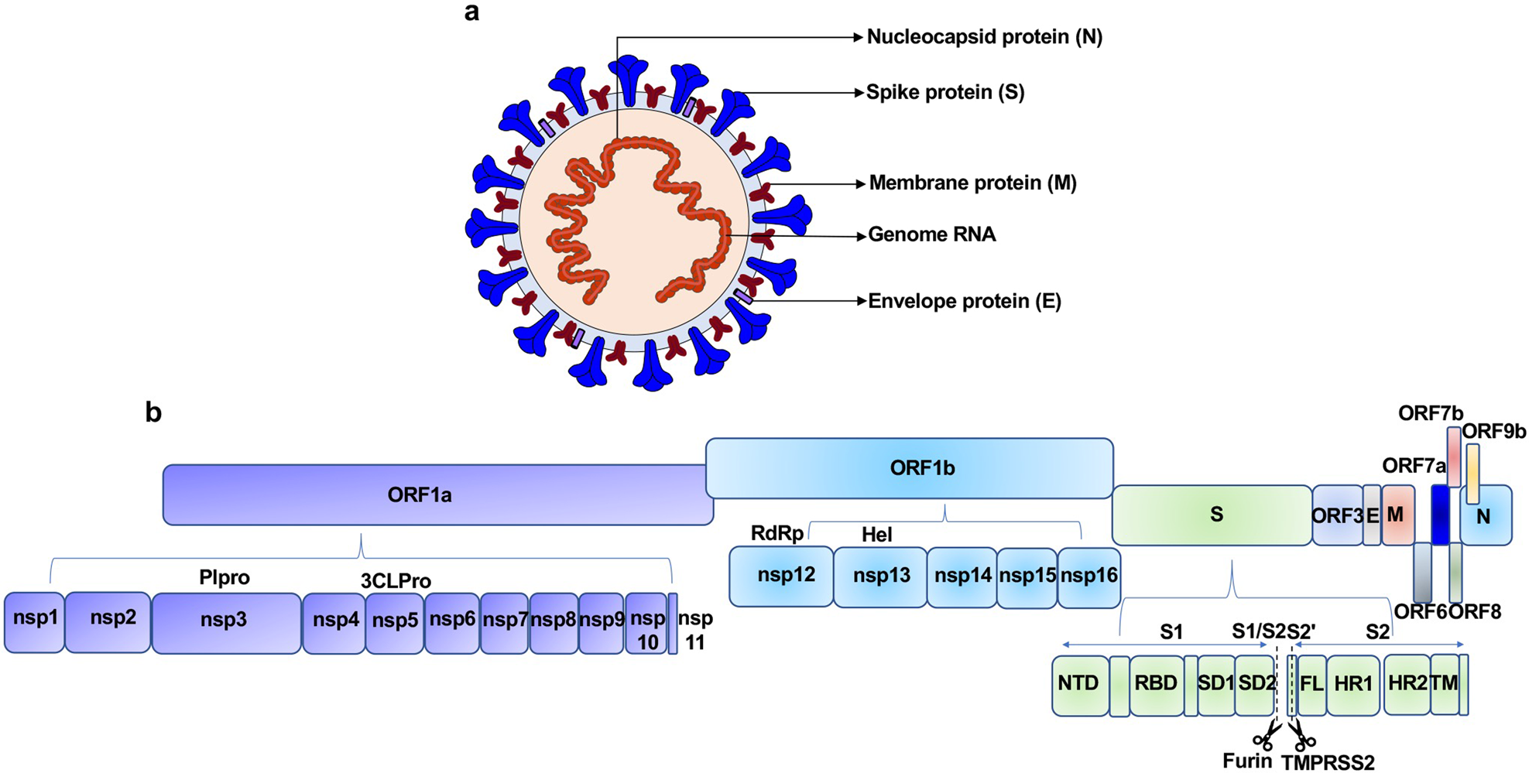
SARS-CoV-2 Genome Structure
(Adapted from Zhang et al. (2021))
Stoch. Dyn. Mod. of evolving gene expression programs
Valencia, July 25th, 2025
Lucas Goiriz, (CSIC – UV; UPV)
Notes:
Genoma de sars cov 2

Slide 65
Gene-Level Mutation Landscape
Analysis of SARS-CoV-2 gene-level mutation accumulation
27 genes analyzed
Most evolved genes:
PLpro, RdRp, S, N, ORF9b
(Adapted from Zhang et al. (2021))
Spike (S) diverged post-Omicron emergence
RdRp: low dispersion despite evolution
Stoch. Dyn. Mod. of evolving gene expression programs
Valencia, July 25th, 2025
Lucas Goiriz, (CSIC – UV; UPV)
Notes:
Genoma de sars cov 2

Slide 66
Gene-Level Mutation Dispersion
Adaptive (non-synonymous) genes:
S, E, N, ORF7a, exonuc.
Purifying selection: nsp9, nsp10 (synonymous)
Alpha and Omicron: bursts of non-synonymous mutations
Delta: stable non-synonymous, drop in synonymous mutations
Peaks in dispersion index corroborate episodic adaptation
Stoch. Dyn. Mod. of evolving gene expression programs
Valencia, July 25th, 2025
Lucas Goiriz, (CSIC – UV; UPV)
Notes:
Genoma de sars cov 2

Slide 67
Non-Linear Gene-Specific Mutation Accumulation
Stoch. Dyn. Mod. of evolving gene expression programs
Valencia, July 25th, 2025
Lucas Goiriz, (CSIC – UV; UPV)
Notes:
Genoma de sars cov 2

Slide 68
Variance Analysis Confirms Anomalous Diffusion
Stoch. Dyn. Mod. of evolving gene expression programs
Valencia, July 25th, 2025
Lucas Goiriz, (CSIC – UV; UPV)
Notes:
Genoma de sars cov 2

Slide 69
Closing Remarks
1. Gene-level dynamics matter: Mutation patterns arise from lineage-specific forces acting on individual genes, beyond genome-wide averages.
2. Mosaic evolutionary behavior: Some genes follow stochastic expectations, while others diverge due to selection or demography, reflecting diverse functional pressures.
3. Ongoing work: Statistical descriptors like dispersion index and power-law fits uncover evolutionary subtleties, with further analyses underway.
Stoch. Dyn. Mod. of evolving gene expression programs
Valencia, July 25th, 2025
Lucas Goiriz, (CSIC – UV; UPV)

Slide 70
Discussion & Conclusions
Stoch. Dyn. Mod. of evolving gene expression programs
Valencia, July 25th, 2025
Lucas Goiriz, (CSIC – UV; UPV)
Notes:
Finally, we’ll enter Chapter 5,

Slide 71
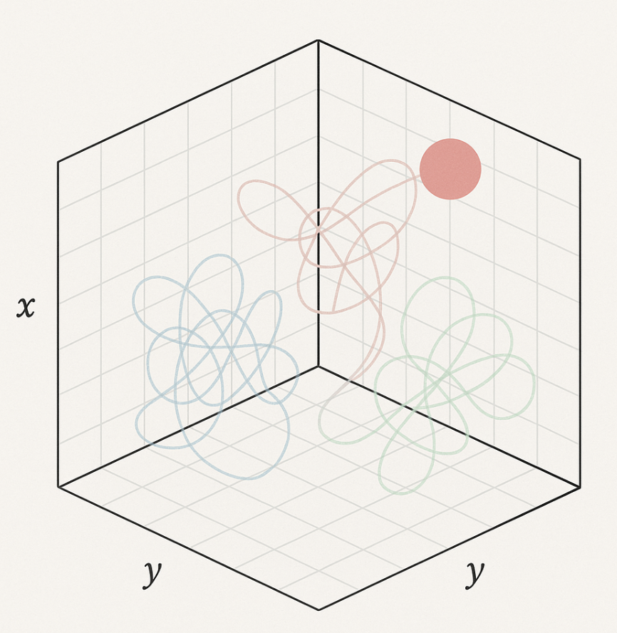
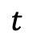
Discussion: Anomalous Diffusion in Viral Genome Evolution
Subdiffusion (Primal, Alpha, Omicron) → slow mutation accumulation
Superdiffusion (Delta) → rapid mutation bursts
Fractional Brownian motion explains nonlinear variance
Evolution behaves like a memory-influenced walk, not a simple Poisson process
$$t$$
Stoch. Dyn. Mod. of evolving gene expression programs
Valencia, July 25th, 2025
Lucas Goiriz, (CSIC – UV; UPV)

Slide 72

Discussion: Limitations of Modeling and Data
Global sequence data is biased by geography, timing, and surveillance intensity
A single diffusion exponent per variant oversimplifies biology
Recombination (though rare) is not modeled and may confound signals
Patterns ≠ mechanisms — results are descriptive, not mechanistic
Stoch. Dyn. Mod. of evolving gene expression programs
Valencia, July 25th, 2025
Lucas Goiriz, (CSIC – UV; UPV)

Slide 73
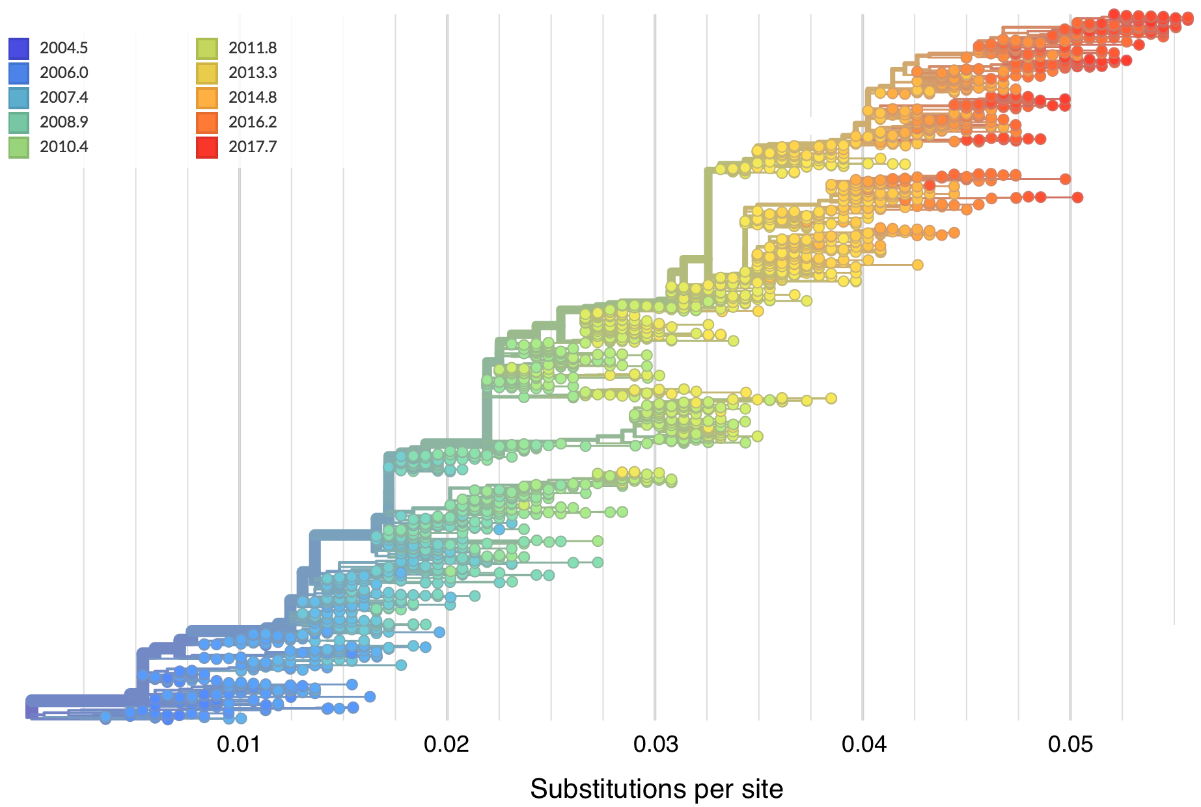
Discussion: Integration
Integrate fractional clocks into phylodynamic models
Compare population-level vs. intrahost evolutionary dynamics
Combine statistical insights with in vitro mutation assays
Ultimately, unify data, experiments, and theory
(Adapted from Nextstrain (2025))
Stoch. Dyn. Mod. of evolving gene expression programs
Valencia, July 25th, 2025
Lucas Goiriz, (CSIC – UV; UPV)

Slide 74
Conclusions
1. RNA Virus evolution can follow variant-dependent, non-Brownian dynamics best described by a stochastic model incorporating fractional Brownian noise, where anomalous diffusion exponents quantify deviations from the classical molecular clock through subdiffusive or superdiffusive evolution rates.
Stoch. Dyn. Mod. of evolving gene expression programs
Valencia, July 25th, 2025
Lucas Goiriz, (CSIC – UV; UPV)

Slide 75
Conclusions
1. RNA Virus evolution can follow variant-dependent, non-Brownian dynamics best described by a stochastic model incorporating fractional Brownian noise, where anomalous diffusion exponents quantify deviations from the classical molecular clock through subdiffusive or superdiffusive evolution rates.
2. Variant-specific analyses reveal distinct mutation accumulation trajectories characterized by bursts in genetic variance during emergence and replacement events, yet converging toward asymptotic Poissonian behavior as captured by a reset-based dispersion index.
Stoch. Dyn. Mod. of evolving gene expression programs
Valencia, July 25th, 2025
Lucas Goiriz, (CSIC – UV; UPV)

Slide 76
Conclusions
1. RNA Virus evolution can follow variant-dependent, non-Brownian dynamics best described by a stochastic model incorporating fractional Brownian noise, where anomalous diffusion exponents quantify deviations from the classical molecular clock through subdiffusive or superdiffusive evolution rates.
2. Variant-specific analyses reveal distinct mutation accumulation trajectories characterized by bursts in genetic variance during emergence and replacement events, yet converging toward asymptotic Poissonian behavior as captured by a reset-based dispersion index.
3. Mutation accumulation in RNA viruses exhibits strong gene-level heterogeneity, deviating from the uniform patterns predicted by classical molecular clock models.
Stoch. Dyn. Mod. of evolving gene expression programs
Valencia, July 25th, 2025
Lucas Goiriz, (CSIC – UV; UPV)

Slide 77
Conclusions
4. Genes under functional constraint exhibit reduced variance and dispersion indicative of purifying selection, genes involved in host interaction undergo episodic adaptive bursts, marked by high dispersion indices and non-monotonic mutation dynamics.
Stoch. Dyn. Mod. of evolving gene expression programs
Valencia, July 25th, 2025
Lucas Goiriz, (CSIC – UV; UPV)

Slide 78
Conclusions
4. Genes under functional constraint exhibit reduced variance and dispersion indicative of purifying selection, genes involved in host interaction undergo episodic adaptive bursts, marked by high dispersion indices and non-monotonic mutation dynamics.
5. A top-down statistical analysis enables detection of localized evolutionary dynamics, revealing how gene-specific contributions shape genome-scale anomalous diffusion.
Stoch. Dyn. Mod. of evolving gene expression programs
Valencia, July 25th, 2025
Lucas Goiriz, (CSIC – UV; UPV)

Slide 79
Conclusions
4. Genes under functional constraint exhibit reduced variance and dispersion indicative of purifying selection, genes involved in host interaction undergo episodic adaptive bursts, marked by high dispersion indices and non-monotonic mutation dynamics.
5. A top-down statistical analysis enables detection of localized evolutionary dynamics, revealing how gene-specific contributions shape genome-scale anomalous diffusion.
6. Non-phylogenetic, population-level approaches offer scalable alternatives for modeling large viral datasets, underscoring the importance of implementing and distributing these novel models as open-source software to ensure broad accessibility and reproducibility.
Stoch. Dyn. Mod. of evolving gene expression programs
Valencia, July 25th, 2025
Lucas Goiriz, (CSIC – UV; UPV)

Slide 80
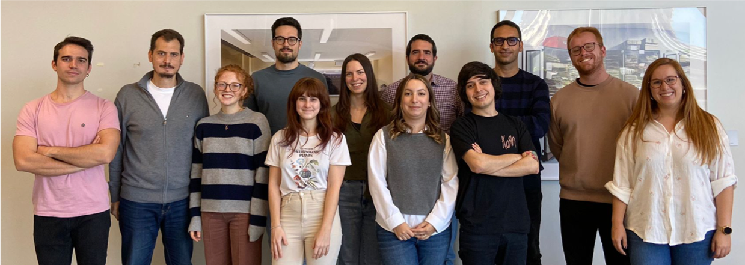


BioSystems Design at Rodrigolab
GVA ACIF 2021/083
Stoch. Dyn. Mod. of evolving gene expression programs
Valencia, July 25th, 2025
Lucas Goiriz, (CSIC – UV; UPV)
Notes:
The group

Slide 81
Stochastic dynamic modeling of evolving gene expression programs
All the effects of Nature are only the mathematical consequences of a small number of immutable laws
— Pierre-Simon Laplace
GVA ACIF 2021/083
Stoch. Dyn. Mod. of evolving gene expression programs
Valencia, July 25th, 2025
Lucas Goiriz, (CSIC – UV; UPV)
Notes:
\definecolor{netgreen}{RGB}{47,228,200}
\definecolor{darkergreen}{RGB}{47,202,163}
\definecolor{darkestgreen}{RGB}{47,175,145}
\definecolor{lightgreen}{RGB}{91,247,212}
Diapo auxiliar del addendum después de esta?

